Slide 1
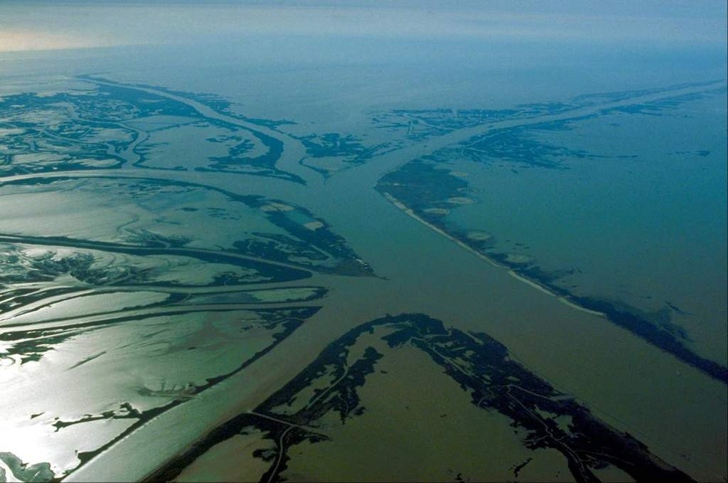
MRHDMS DATA COLLECTION PROGRAM Mead Allison¹ & Thad Pratt² ¹ Water Institute of the Gulf ² ERDC
Notes:
1) Better inform the placement and operations of the diversions included in the Master Plan. River diversions are a critical piece of the State Master Plan. However, there are still some remaining scientific questions regarding the implementation of diversion: how will these diversions affect the Mississippi River and how will the diversions affect the receiving basins? This study will investigate these questions.

Slide 2
Data Collection Objectives
Carry out a 24 mo** field measurement program in the lowermost Mississippi River beginning Spring/Summer 2012 to:
Formulate grids, calibrate and validate 1D and multi-dimensional models
**Phase I
Notes:
Although the two studies are separate in the LCA 2004 report, we and the USACE decided to combine the two studies, so that we weren’t only focusing on tool development.
The PMP and cost share were signed in August 2011. After that, we developed work plans for each task and began work. The study is a 5 year study for $10 million.

Slide 3
Data Collection Objectives
Carry out a 24 mo** field measurement program in the lowermost Mississippi River beginning Spring/Summer 2012 to:
Study poorly understood hydrodynamic and sediment transport processes in the channel (relevant to sand mining and diversions)
Lateral Bar Dynamics (controls sand in suspension)
Salt Wedge Dynamics (controls trapping of fines in Venice-to-HOP)
Reduction in River Power Downstream (controls suspended load)
**Phase I
Notes:
Although the two studies are separate in the LCA 2004 report, we and the USACE decided to combine the two studies, so that we weren’t only focusing on tool development.
The PMP and cost share were signed in August 2011. After that, we developed work plans for each task and began work. The study is a 5 year study for $10 million.

Slide 4
Data Collection Objectives
Carry out a 24 mo** field measurement program in the lowermost Mississippi River beginning Spring/Summer 2012 to:
Establish monitoring stations and conduct boat-based measurements using two field teams (one Federal, one State)
No monitoring station below Belle Chasse (RM75)
Limited turbidity and nitrate monitoring
**Phase I
Notes:
Although the two studies are separate in the LCA 2004 report, we and the USACE decided to combine the two studies, so that we weren’t only focusing on tool development.
The PMP and cost share were signed in August 2011. After that, we developed work plans for each task and began work. The study is a 5 year study for $10 million.

Slide 5
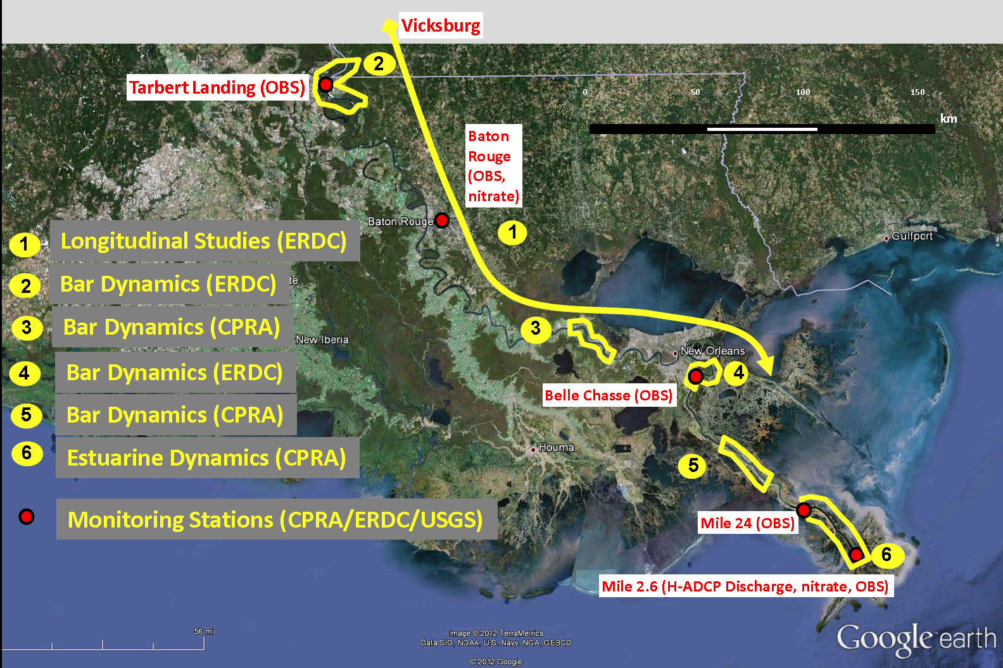
MRHDMS Data Collection Study Design
Notes:
The study area is from the Old River Control Complex to the Gulf of Mexico. The Atchafalaya River is not included in our study area. We know that the Atchafalaya is a component of the river system and definitely have an influence on the Mississippi, but we did not have the resources to invest in both the Atchafalaya and Mississippi Rivers. There are several ongoing initiatives in the Atchafalaya, including the development of a sediment budget and modeling.

Slide 6
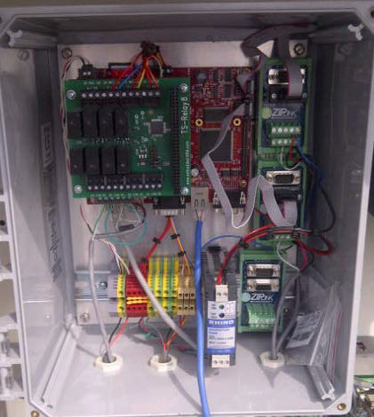
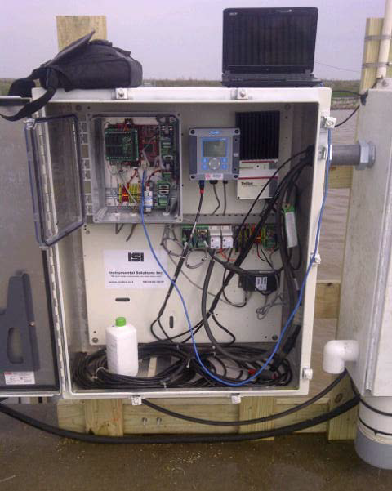
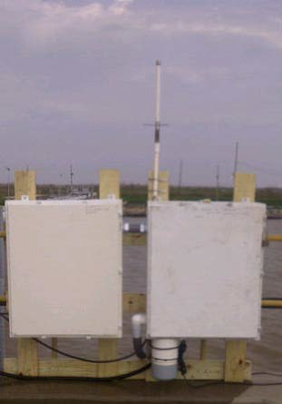
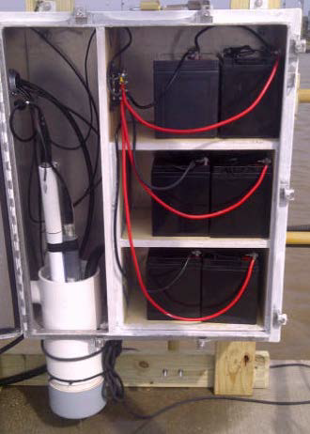
RM2.6 (Pilottown)
Monitoring Station
Velocity (discharge), Nitrate, Salinity
Turbidity

Slide 7
Bar Dynamics Surveys
4 sites (Old River, Bonnet Carre, Caernarvon, Bohemia)
Cross-sectional and longitudinal water velocities and discharge
Suspended load
- flux
- concentration vertically and spatially
- grain size distribution
Bed load flux
Bathymetry of study reach
Bed morphology (dune) variability
Bed sediment character (grain size and bulk properties)
Notes:
The study area is from the Old River Control Complex to the Gulf of Mexico. The Atchafalaya River is not included in our study area. We know that the Atchafalaya is a component of the river system and definitely have an influence on the Mississippi, but we did not have the resources to invest in both the Atchafalaya and Mississippi Rivers. There are several ongoing initiatives in the Atchafalaya, including the development of a sediment budget and modeling.

Slide 8
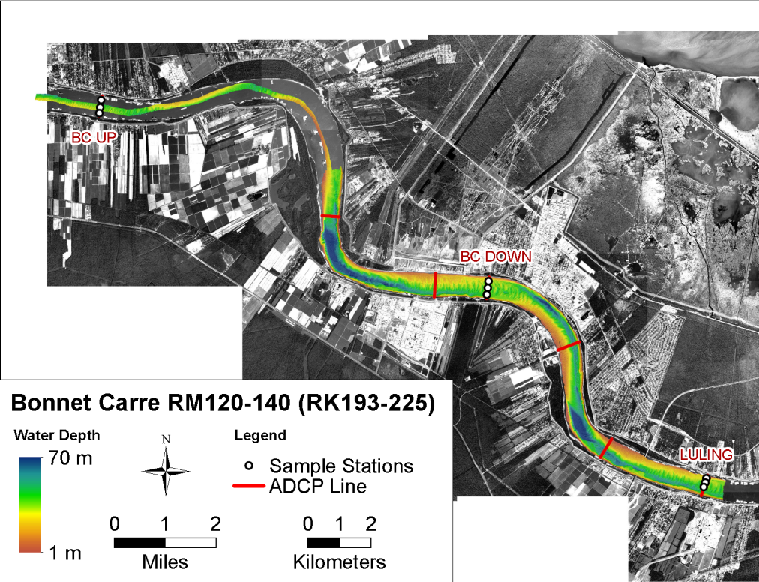
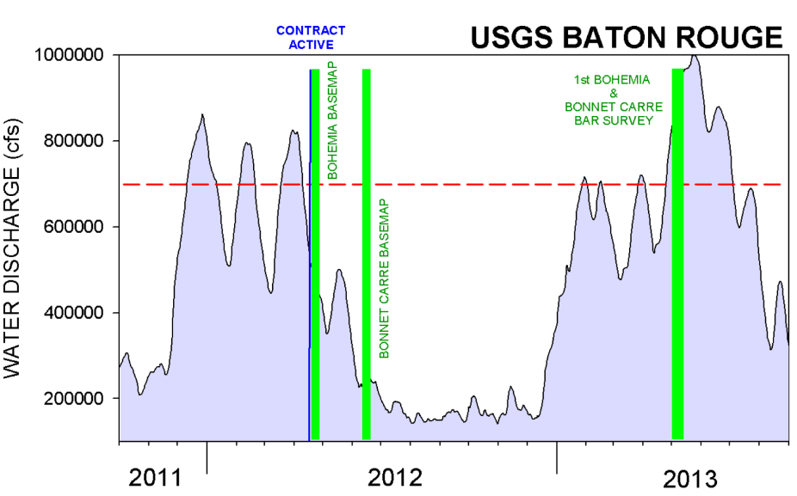
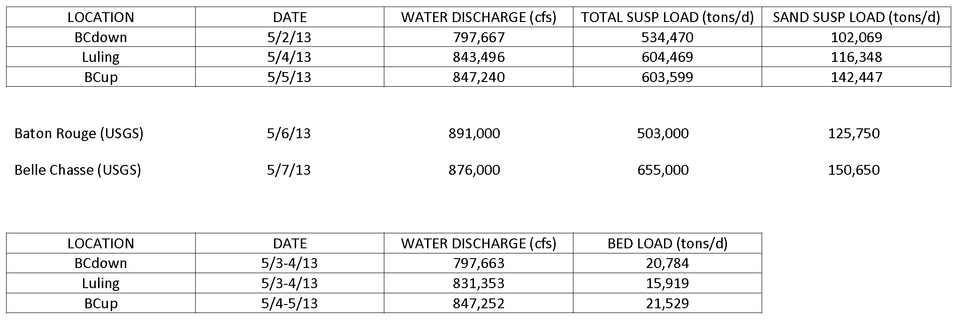
Bar Dynamics Surveys:
Bonnet Carre
May 2013
Notes:
The study area is from the Old River Control Complex to the Gulf of Mexico. The Atchafalaya River is not included in our study area. We know that the Atchafalaya is a component of the river system and definitely have an influence on the Mississippi, but we did not have the resources to invest in both the Atchafalaya and Mississippi Rivers. There are several ongoing initiatives in the Atchafalaya, including the development of a sediment budget and modeling.

Slide 9
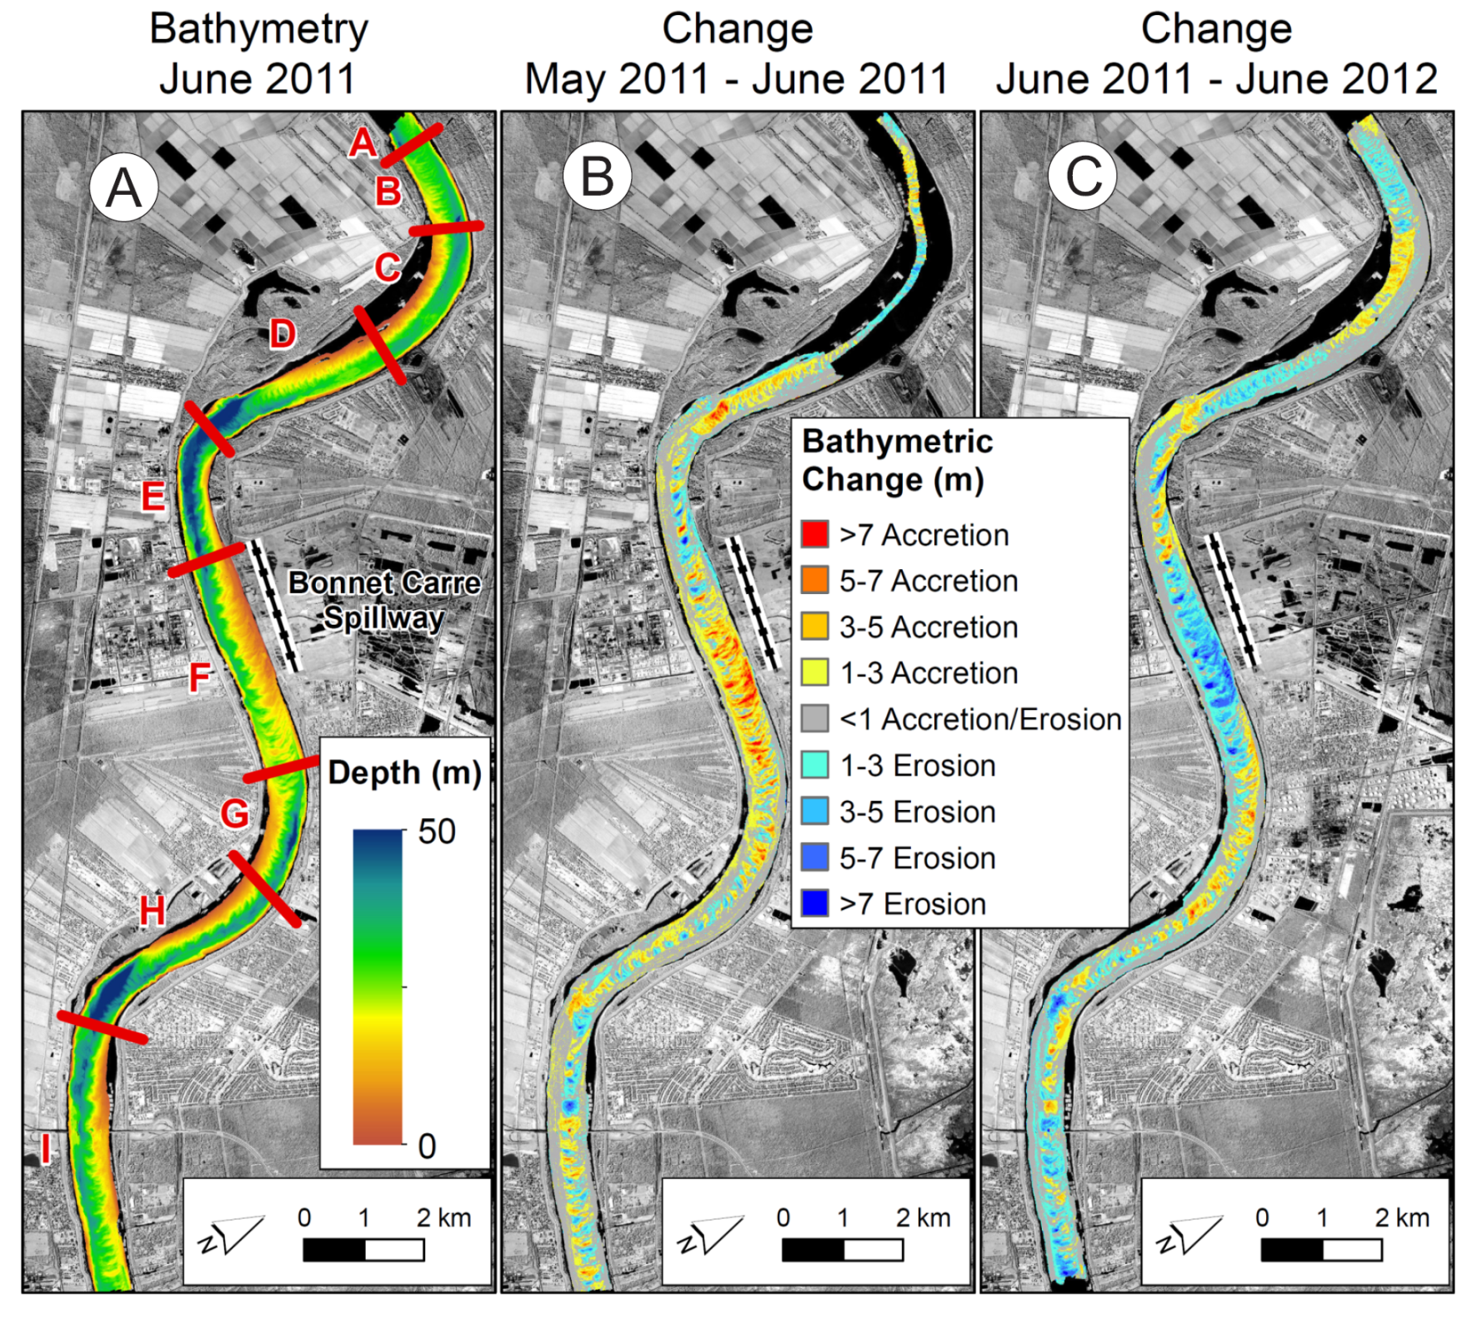
Bar Dynamics
Surveys:
Bonnet Carre
2011 Flood at
Bonnet Carre
Spillway
J. of Hydrology
Allison et al. (2013)
Notes:
The study area is from the Old River Control Complex to the Gulf of Mexico. The Atchafalaya River is not included in our study area. We know that the Atchafalaya is a component of the river system and definitely have an influence on the Mississippi, but we did not have the resources to invest in both the Atchafalaya and Mississippi Rivers. There are several ongoing initiatives in the Atchafalaya, including the development of a sediment budget and modeling.

Slide 10
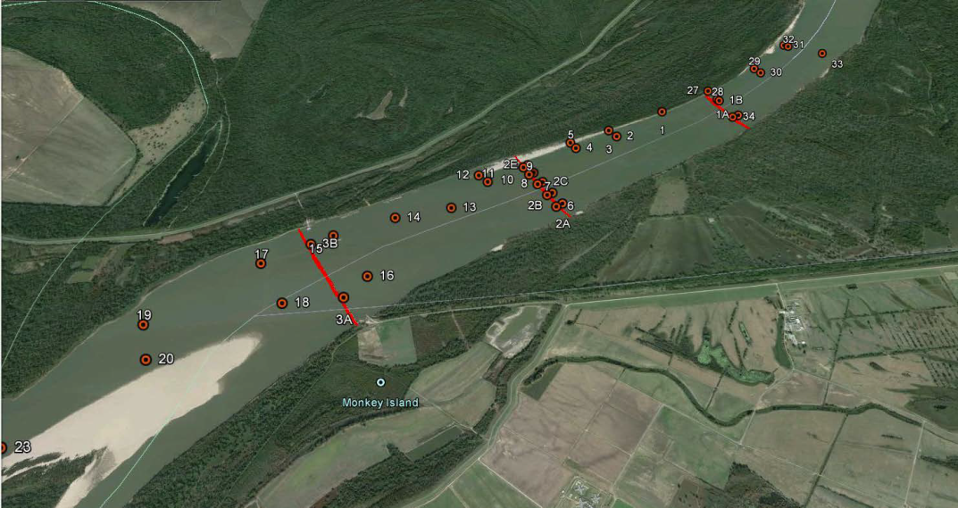
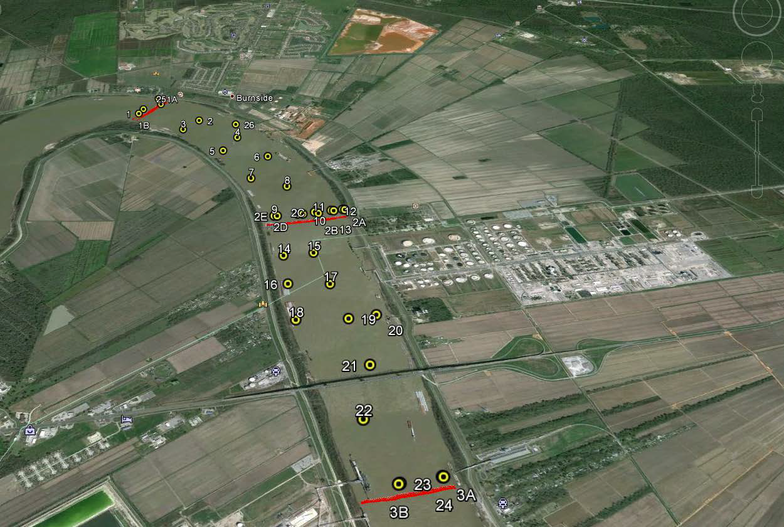
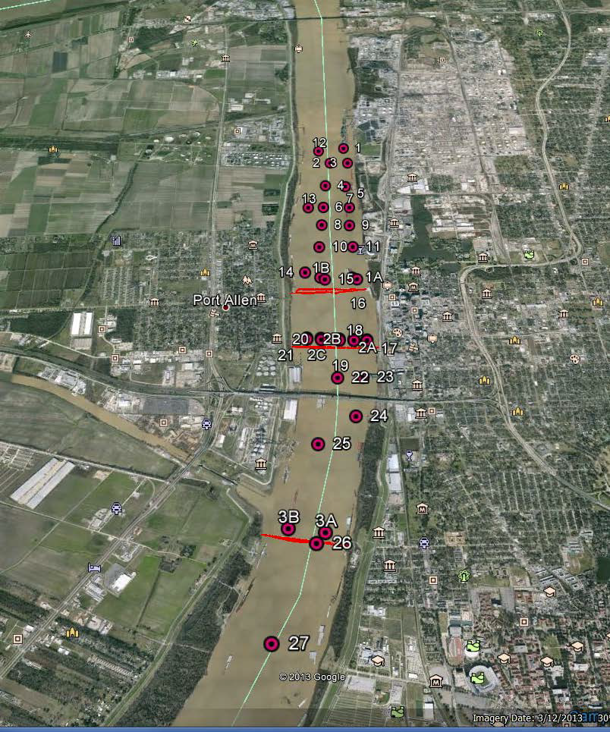
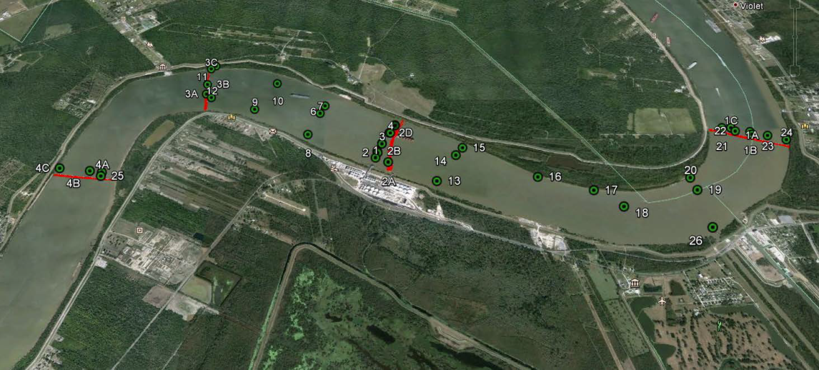
Longitudinal Studies (follow a water mass, 7 sites)
Tarbert Site RM 310-302
Convent Site RM 171-166
Baton
Rouge
Site
RM
232-227
Caernarvon Site RM 83-78
Notes:
The study area is from the Old River Control Complex to the Gulf of Mexico. The Atchafalaya River is not included in our study area. We know that the Atchafalaya is a component of the river system and definitely have an influence on the Mississippi, but we did not have the resources to invest in both the Atchafalaya and Mississippi Rivers. There are several ongoing initiatives in the Atchafalaya, including the development of a sediment budget and modeling.

Slide 11
Estuarine Dynamics
Wedge penetration zone (RM63 to HOP) surveys focused on RM24 to HOP. Two studies (2012, 2013) when river discharge <300,000 cfs.
Bathymetry (mainstem and important trunk channels)
Longitudinal and cross-sectional water velocities
Salinity and turbidity characteristics
Stored bed sediment character (grain size and bulk properties)
Sediment trapping phenomenon (turbidity maxima, aggregation)
Time-series studies of salt wedge migration (tidal, discharge)
Notes:
The study area is from the Old River Control Complex to the Gulf of Mexico. The Atchafalaya River is not included in our study area. We know that the Atchafalaya is a component of the river system and definitely have an influence on the Mississippi, but we did not have the resources to invest in both the Atchafalaya and Mississippi Rivers. There are several ongoing initiatives in the Atchafalaya, including the development of a sediment budget and modeling.

Slide 12
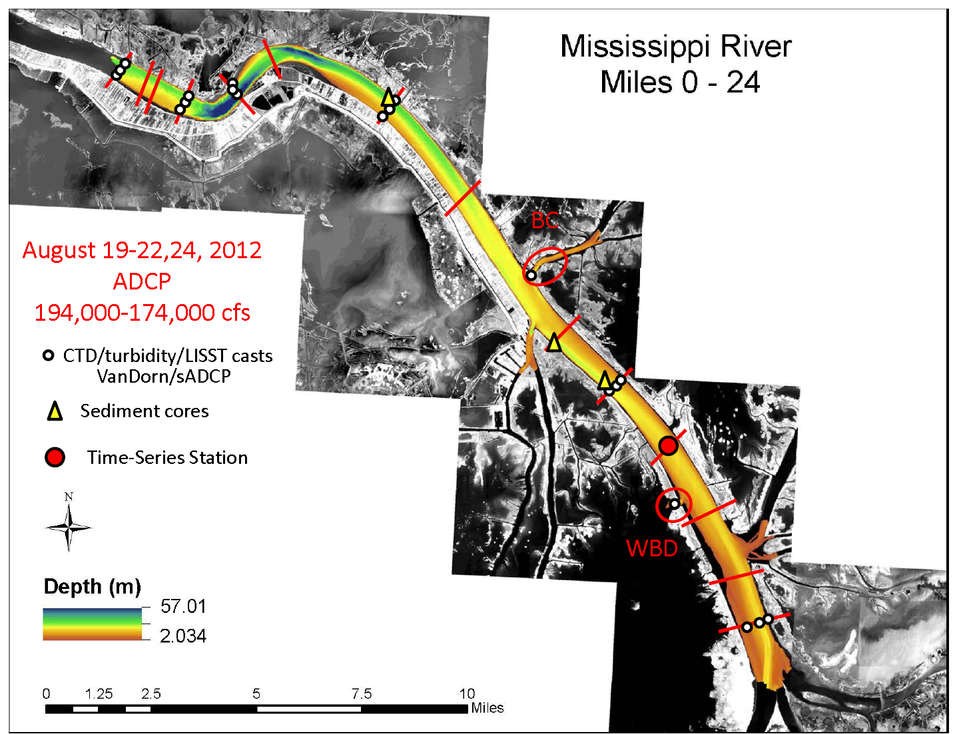
Estuarine Dynamics
SURVEY
DESIGN
Fall 2012
BATHYMETRY
CONDUCTED
April-June 2012
Notes:
The study area is from the Old River Control Complex to the Gulf of Mexico. The Atchafalaya River is not included in our study area. We know that the Atchafalaya is a component of the river system and definitely have an influence on the Mississippi, but we did not have the resources to invest in both the Atchafalaya and Mississippi Rivers. There are several ongoing initiatives in the Atchafalaya, including the development of a sediment budget and modeling.

Slide 13
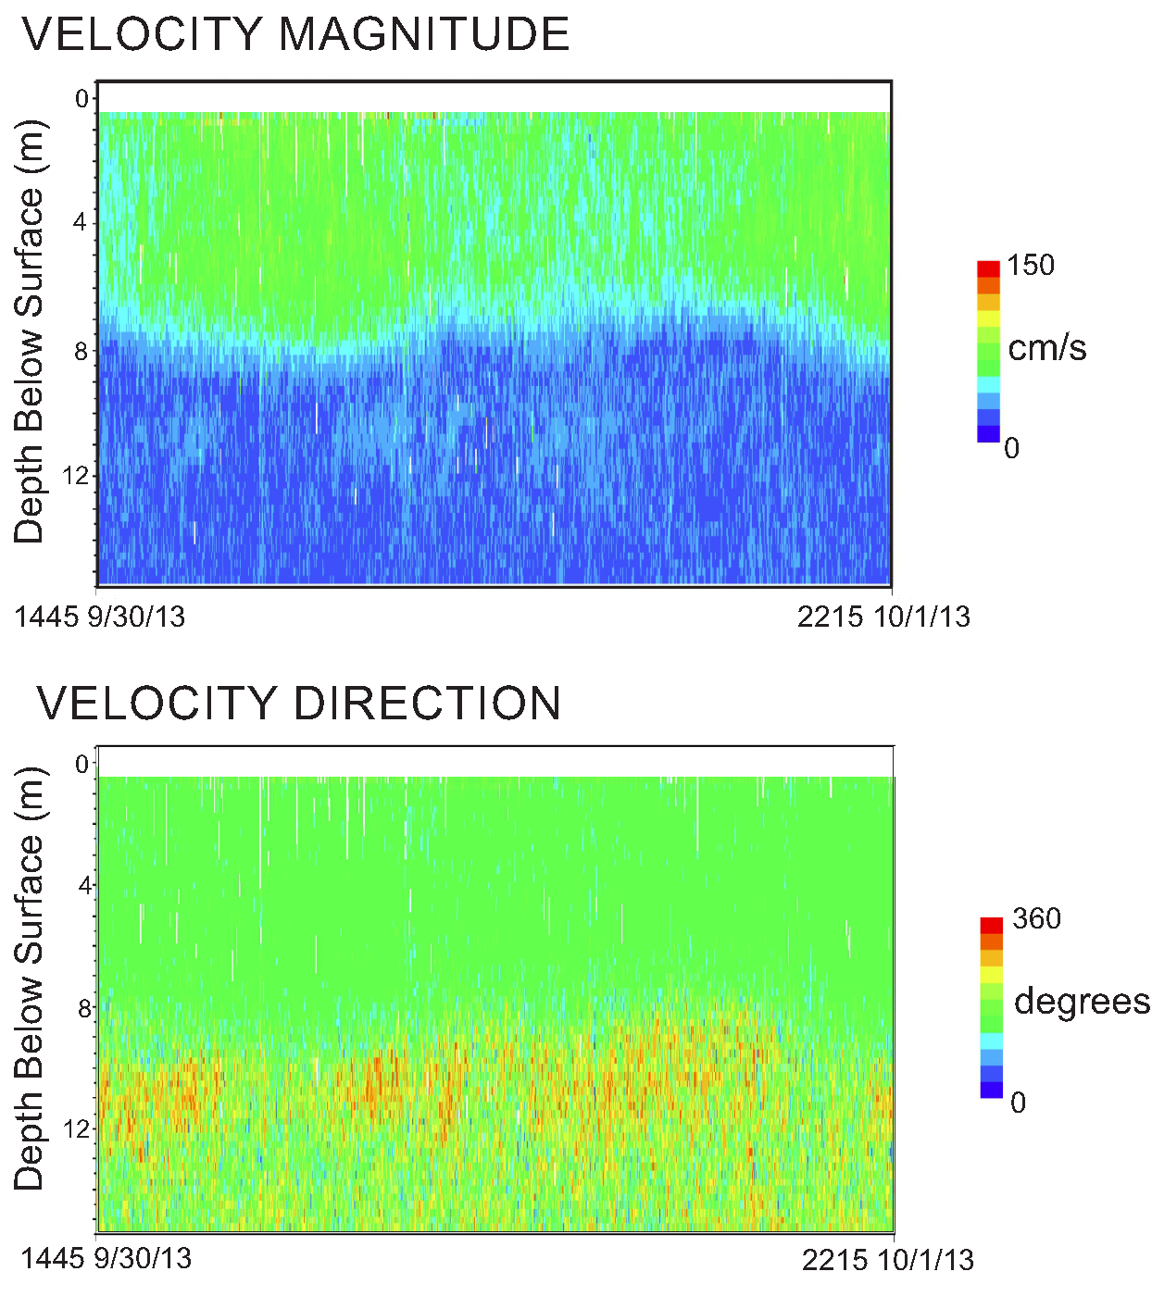
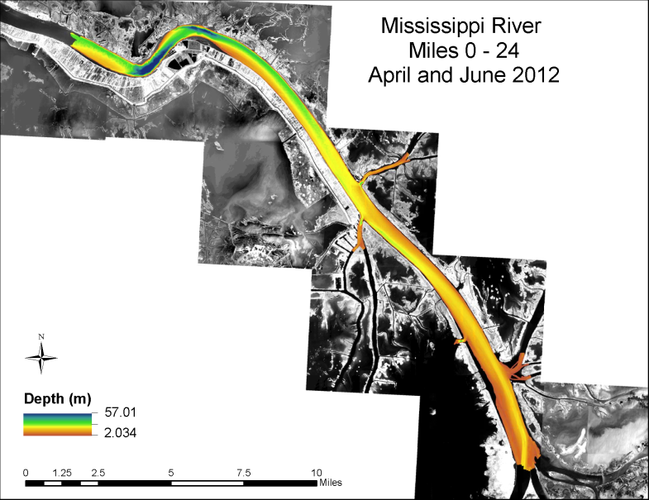
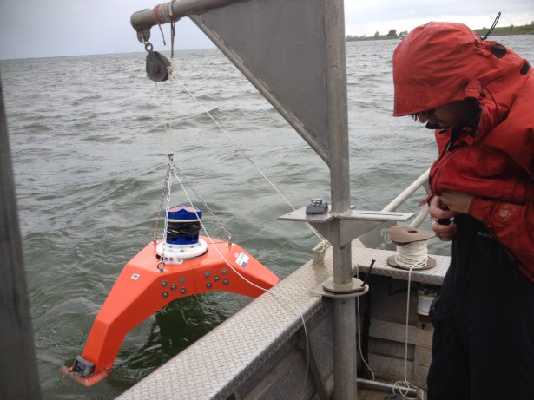
Estuarine Dynamics
TIME SERIES STUDIES
Uplooking ADCP Fall 2013
T-S Station
Notes:
The study area is from the Old River Control Complex to the Gulf of Mexico. The Atchafalaya River is not included in our study area. We know that the Atchafalaya is a component of the river system and definitely have an influence on the Mississippi, but we did not have the resources to invest in both the Atchafalaya and Mississippi Rivers. There are several ongoing initiatives in the Atchafalaya, including the development of a sediment budget and modeling.

Slide 14
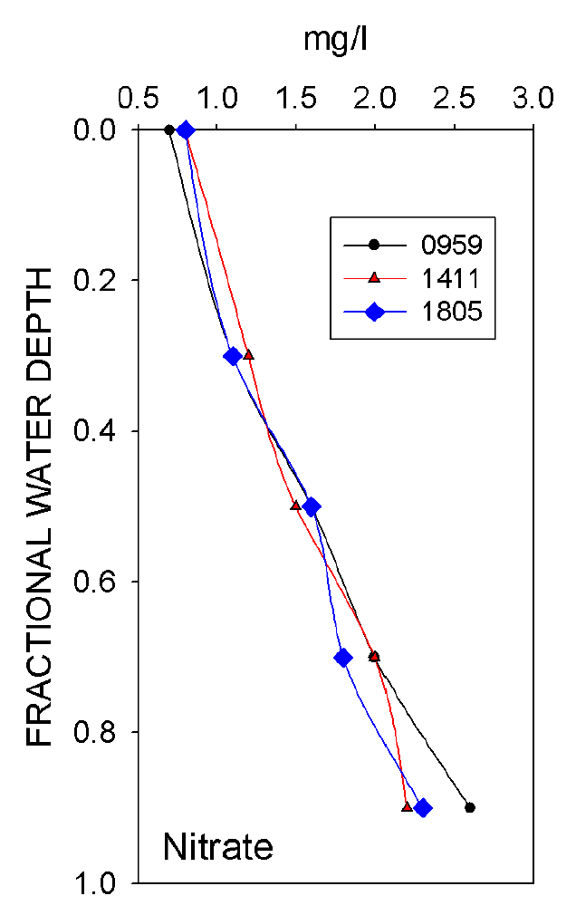
Estuarine Dynamics
NITRATE AVAILABILITY
Fall 2012
T-S Station
Notes:
The study area is from the Old River Control Complex to the Gulf of Mexico. The Atchafalaya River is not included in our study area. We know that the Atchafalaya is a component of the river system and definitely have an influence on the Mississippi, but we did not have the resources to invest in both the Atchafalaya and Mississippi Rivers. There are several ongoing initiatives in the Atchafalaya, including the development of a sediment budget and modeling.

Slide 15
COMPLETED/REMAINING PHASE I DATA COLLECTION EFFORT
All MONITORING STATIONS sensors operating
BAR SURVEYS
Basemapping for grid setup complete
First BAR SURVEYS complete in May 2013 (4 Sites)
Second BAR SURVEYS May 2014
3. LONGITUDINAL SURVEYS
First LONGITUDINAL complete in Oct 2012 (Low Discharge)
Second LONGITUDINAL complete in April-May 2013(Rising-to-High Discharge)
4. ESTUARINE SURVEYS
Basemapping for grid setup complete
First ESTUARINE SURVEY complete in September 2012
Second ESTUARINE SURVEY complete in September-October 2013
Moderate Discharge SW PASS ESTUARINE SURVEY May 2014

