Slide 1
Social impacts and coastal louisiana
Expert Panel on Diversions
April 30, 2014
Craig E. Colten, Ph.D.
and
Scott A. Hemmerling, Ph.D.

Slide 2
Social impact assessment
Seeks to identify consequences of environmental project to human population
Fundamental part of EIS process for projects, programs, or policies
Elevate consideration of human communities
Provide communities with opportunities for engagement and to minimize conflicts
Water Institute convened panel to consider social, economic, and environmental justice issues associated with diversions and other coastal restoration projects and outline methods for SIA

Slide 3
Sia objectives
Achieve extensive understanding of local and regional setting;
Focus on key elements of the human environment related to, and impacted by, project, program, or policy;
Utilize sound and replicable social scientific concepts and methods
Provide quality information for decision making;
Ensure that environmental justice issues are fully described and analyzed;
Undertake project, program, or policy evaluation/monitoring and mitigation.

Slide 4
SIA Methods
Develop a public involvement process;
Describe proposed action and alternatives;
Describe a relevant human environment and zones of influence;
Identify probable impacts;
Investigate probable impacts;
Determine the probable responses of affected stakeholders;
Estimate secondary and cumulative impacts;
Recommend changes in proposed action or alternatives;
Develop mitigation, remediation, and enhancement efforts;
Develop and implement monitoring;
Report preparation and delivery.
(ICPGSIA 2003)

Slide 5
SIA SOURCES AND INSIGHTS
An abundance of available information exists
Illustrates dynamics of Louisiana’s coastal area
  Population change over time
  Resettlement and adaptation
  Economic adjustments
  Human – environment interactions
SIA complements environmental analyses

Slide 6
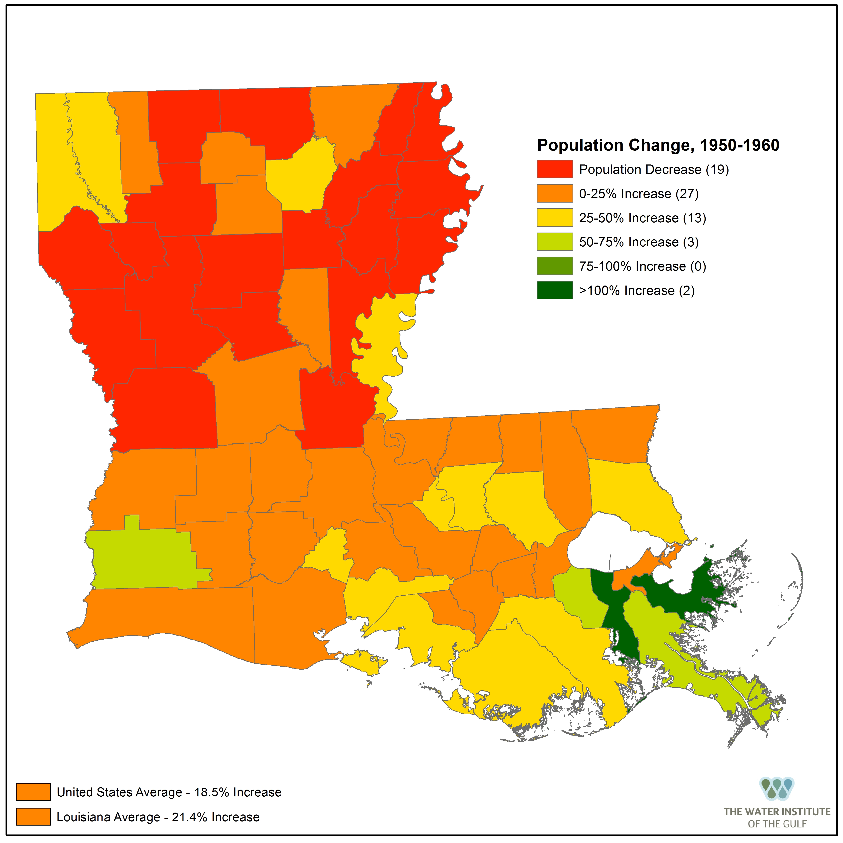
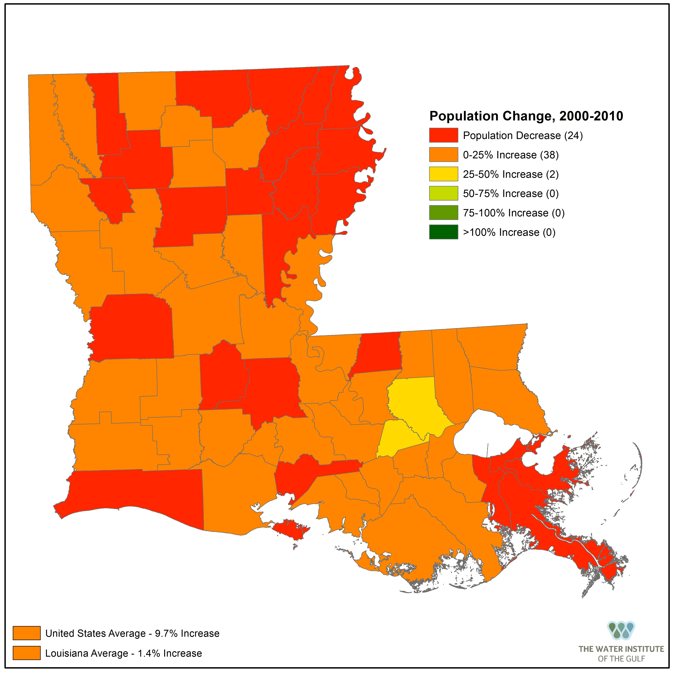
Population change

Slide 7
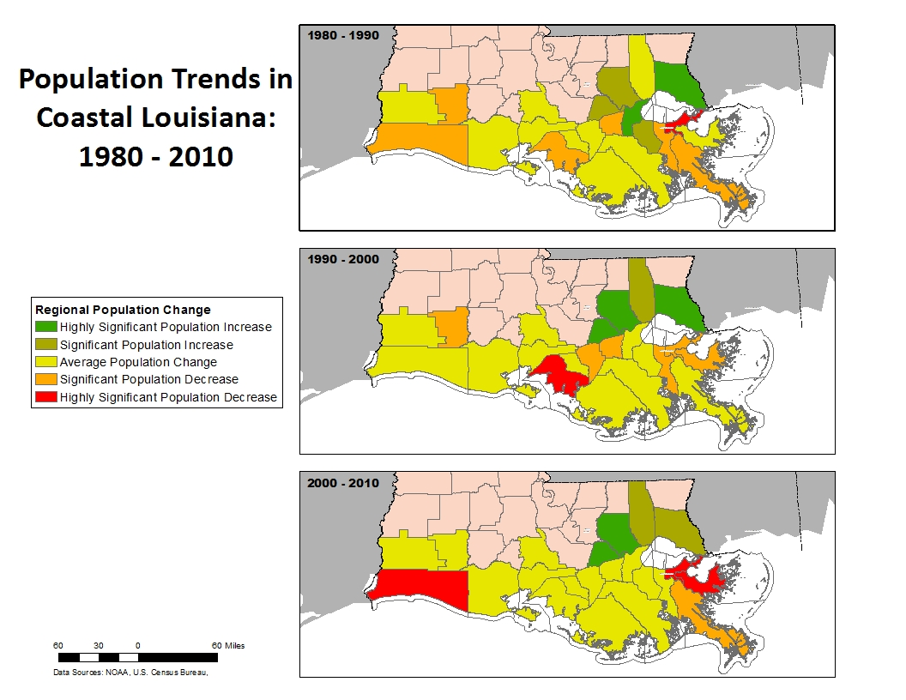
Population trends in coastal Louisiana: 1980 - 2010

Slide 8
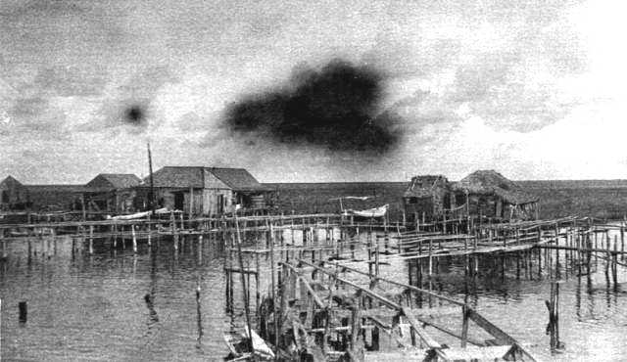
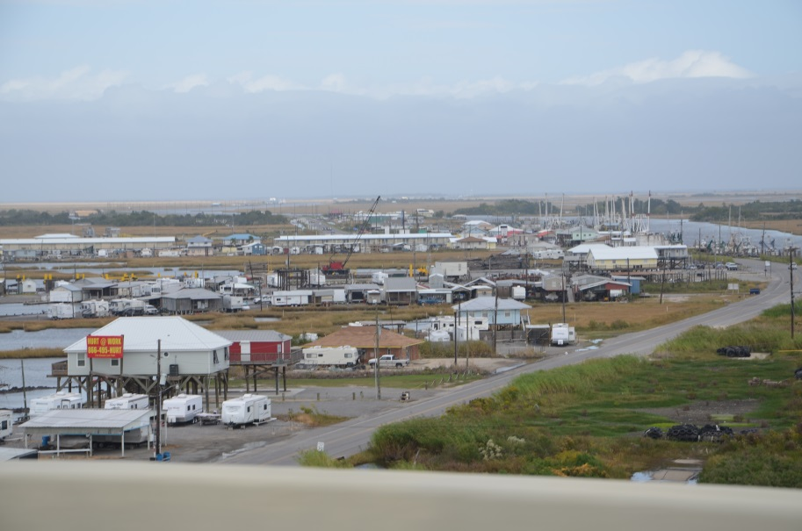
Resettlement
Chenier Caminada
Leeville

Slide 9
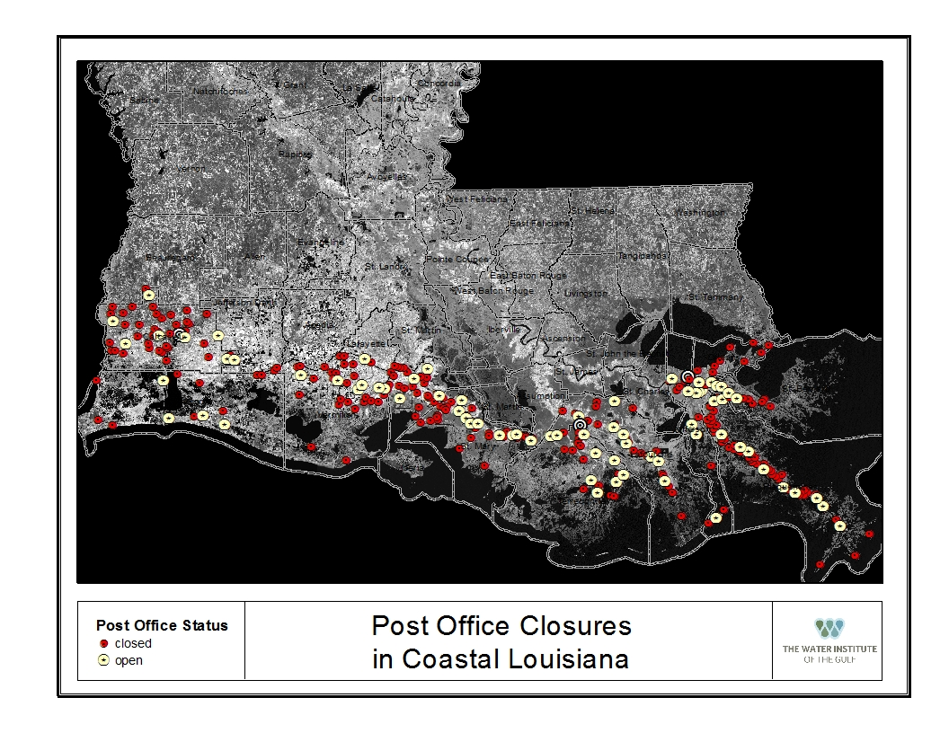
Resettlement

Slide 10
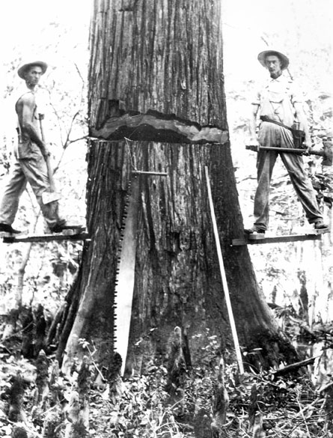
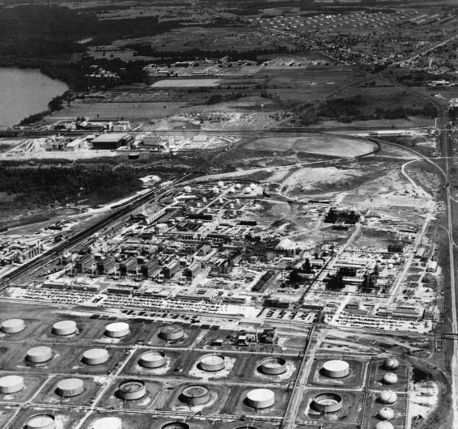
Economic changes

Slide 11
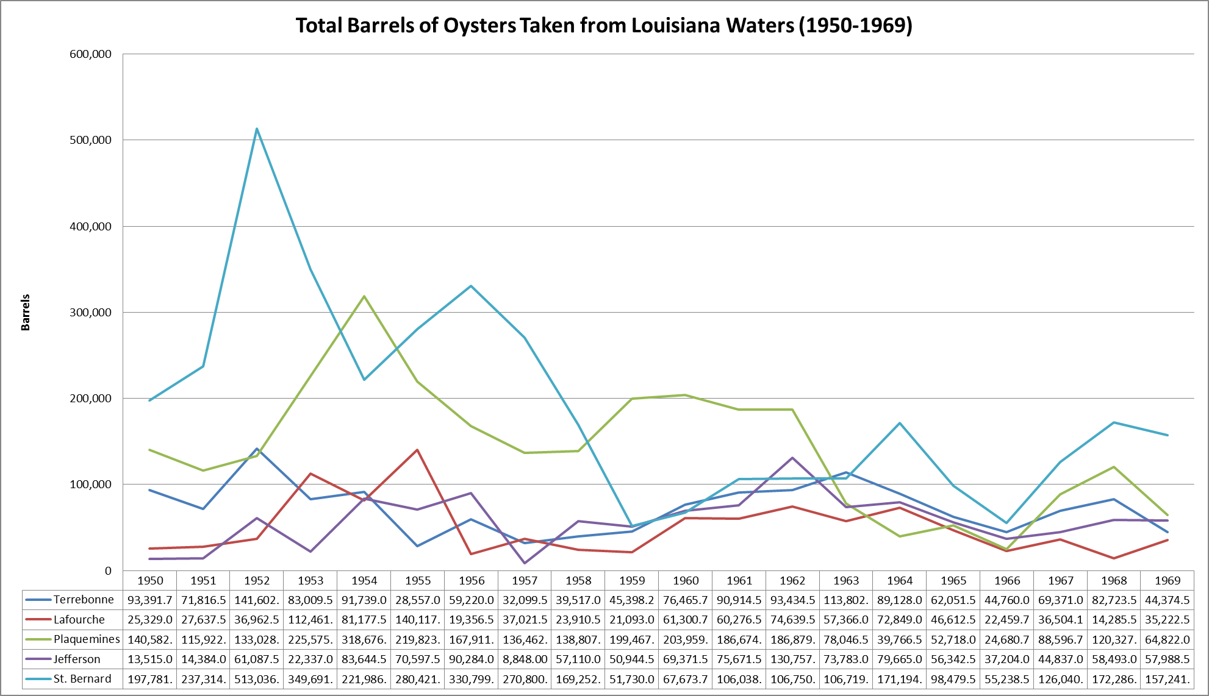

Slide 12
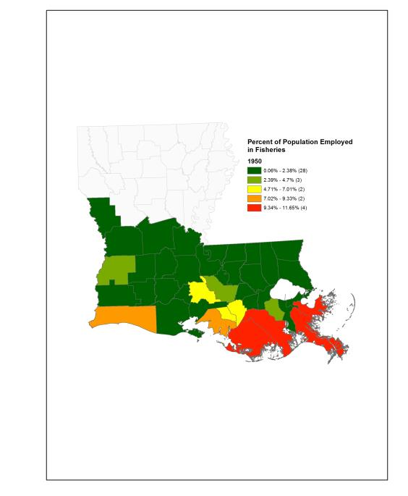
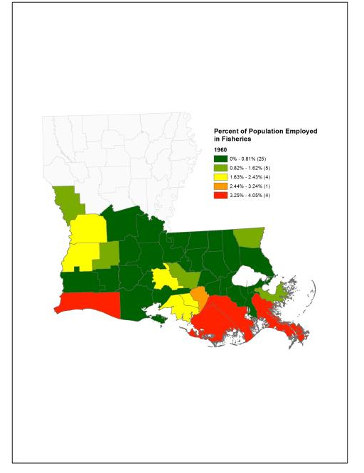
ECONOMIC CHANGE AND POPULATION ADJUSTMENTS

Slide 13
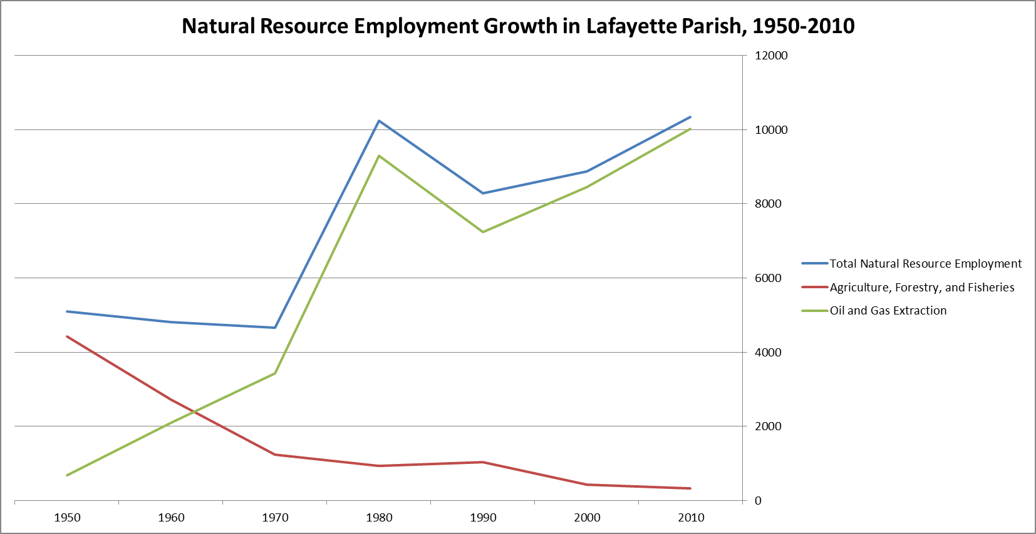

Slide 14
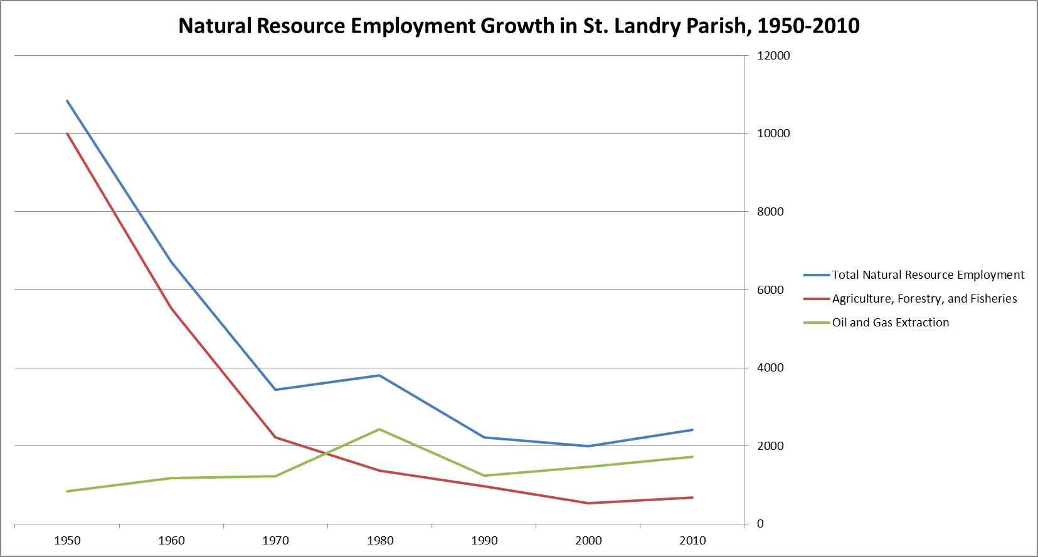

Slide 15
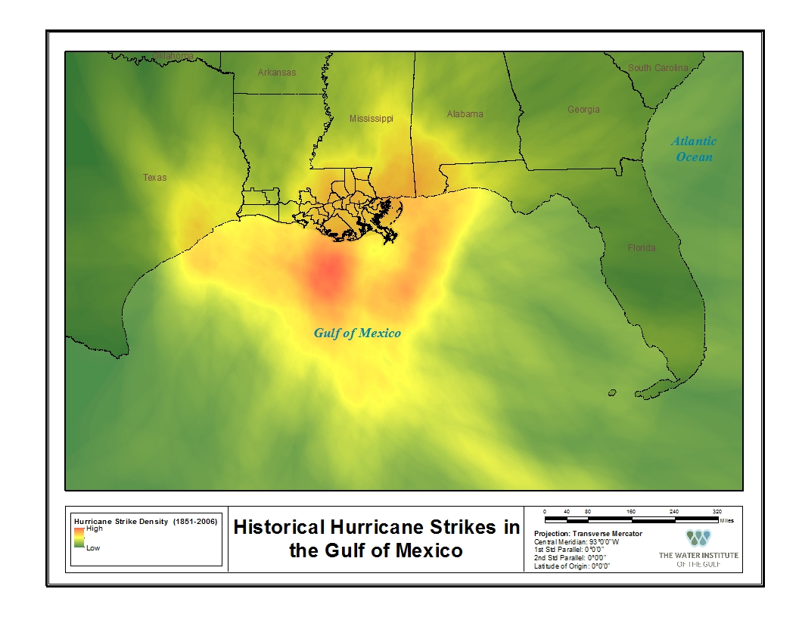
Historical hurricanes 1851 - 2006

Slide 16
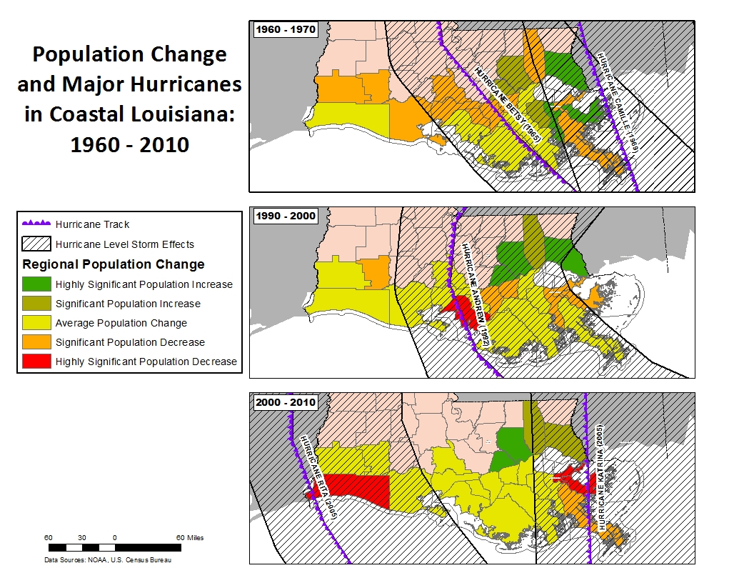
Population change and major hurricanes in coastal Louisiana: 1960 - 2010

Slide 17
CONCLUSIONS
SIAs complement environmental analysis
Provide insight into complex human issues
Allow participation of and engagement with stakeholders
Facilitate environmental management

Slide 18
Thank You
Questions?

Slide 19
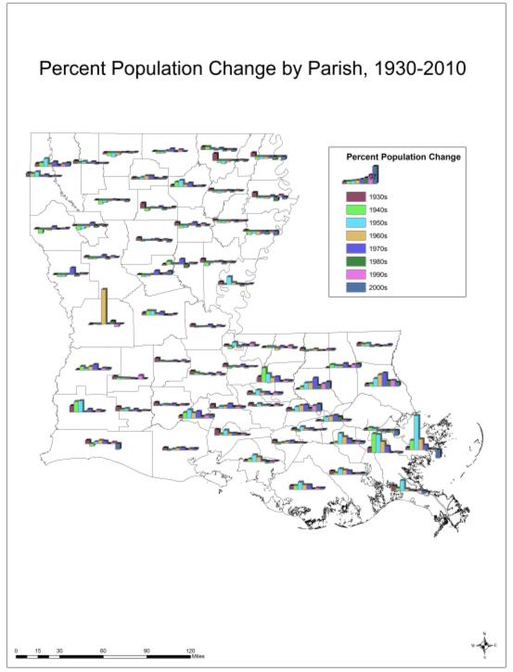
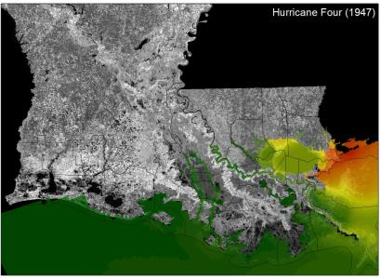
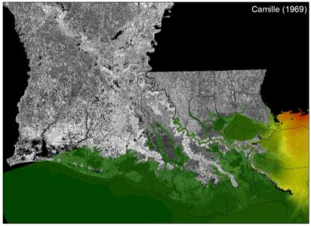
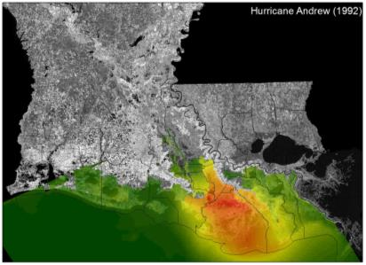
STORM SURGE AND POPULATION ADJUSTSMENTS

