Slide 1

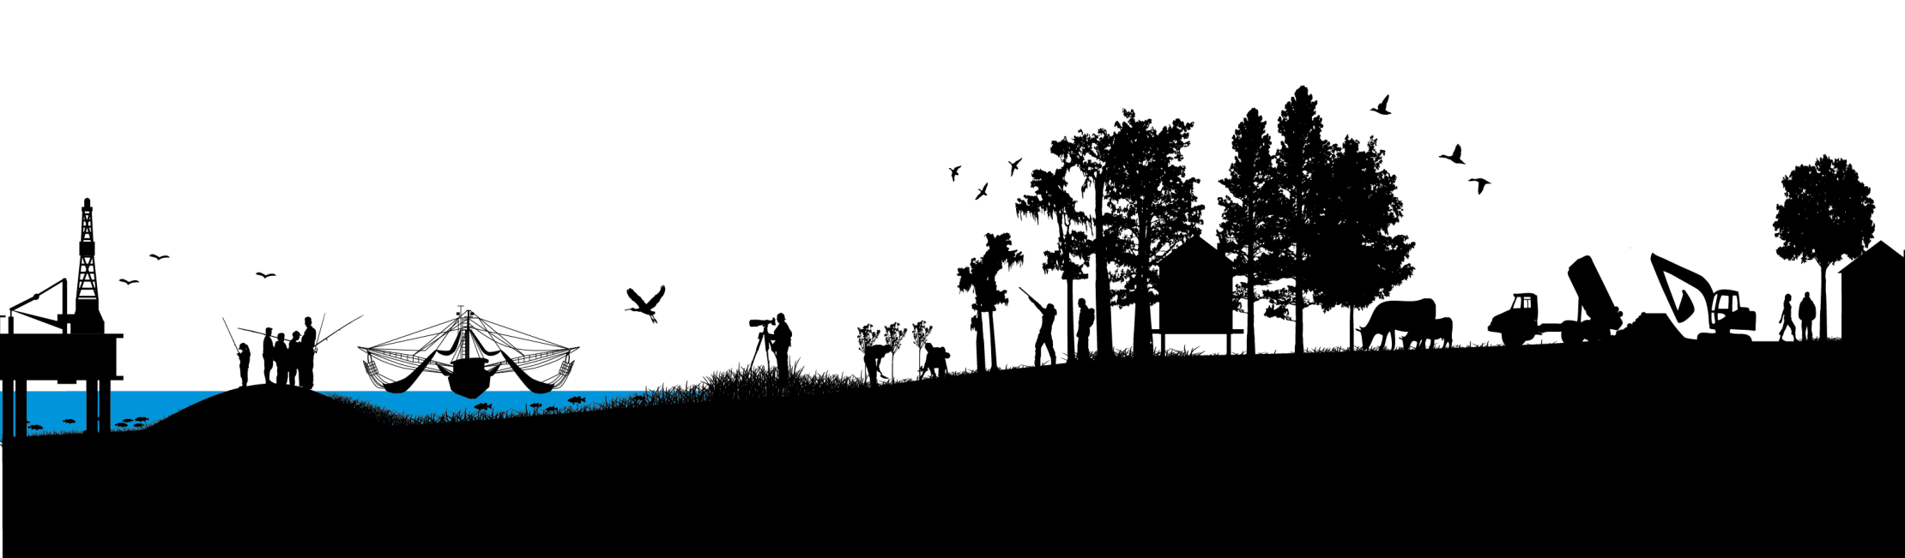
Diversions Update
Kyle Graham, CPRA
Presentation to Diversions Advisory Panel, Meeting #2
April 30, 2014
committed to our coast
committed to our coast

Slide 2
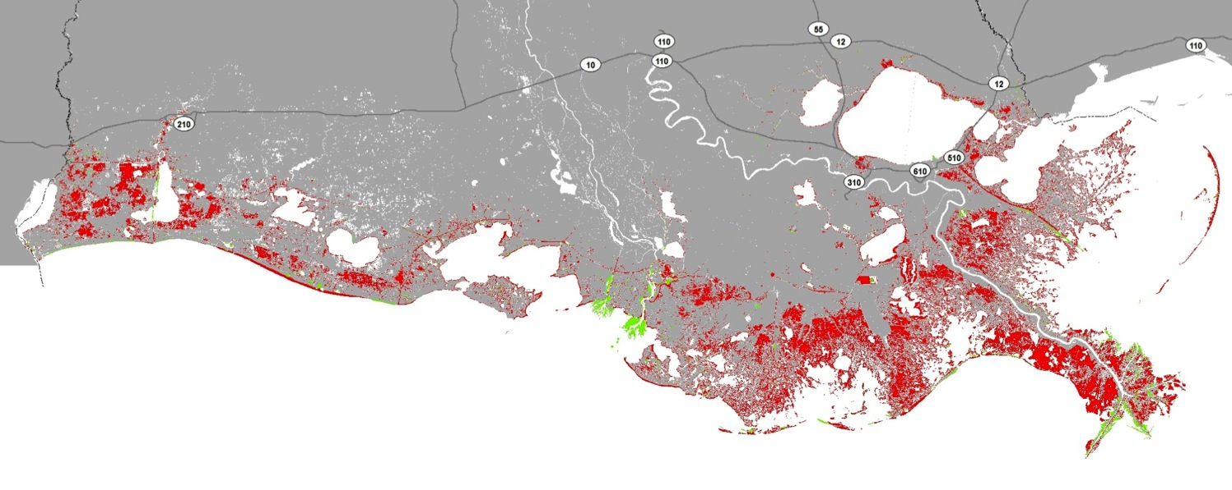
Land Area Change in Coastal LA
1932 – 2010
Land Loss
Land Gain

Slide 3
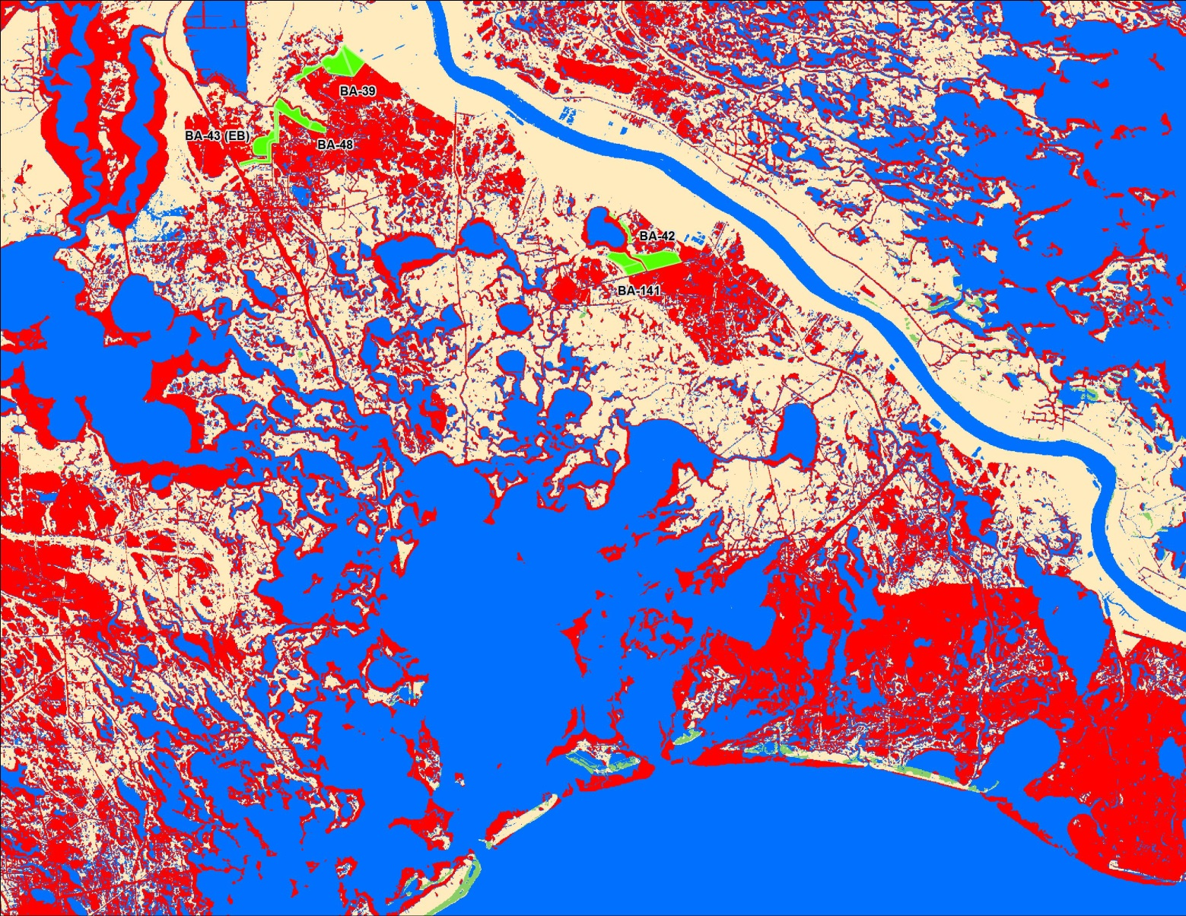
Rebuilding an Inactive Delta
Bayou Dupont - $26M
Long Distance Sediment Pipeline $104M
Lake Hermitage - $51M

Slide 4
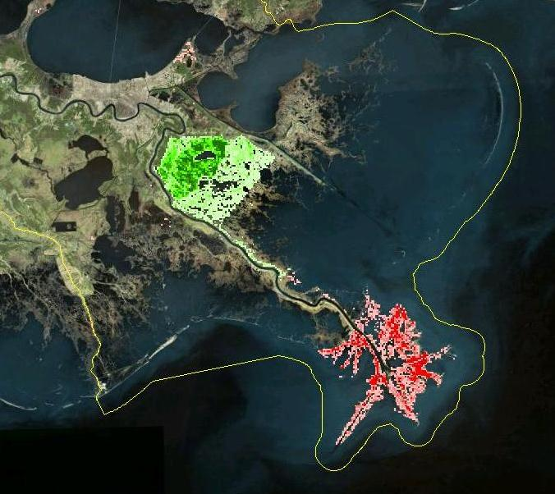
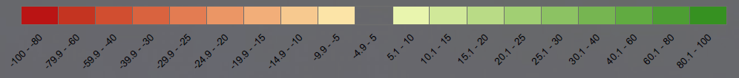
Example of Project Evaluation
Year 50
Change in Percent Land Compared to FWOA
Scenario B

Slide 5
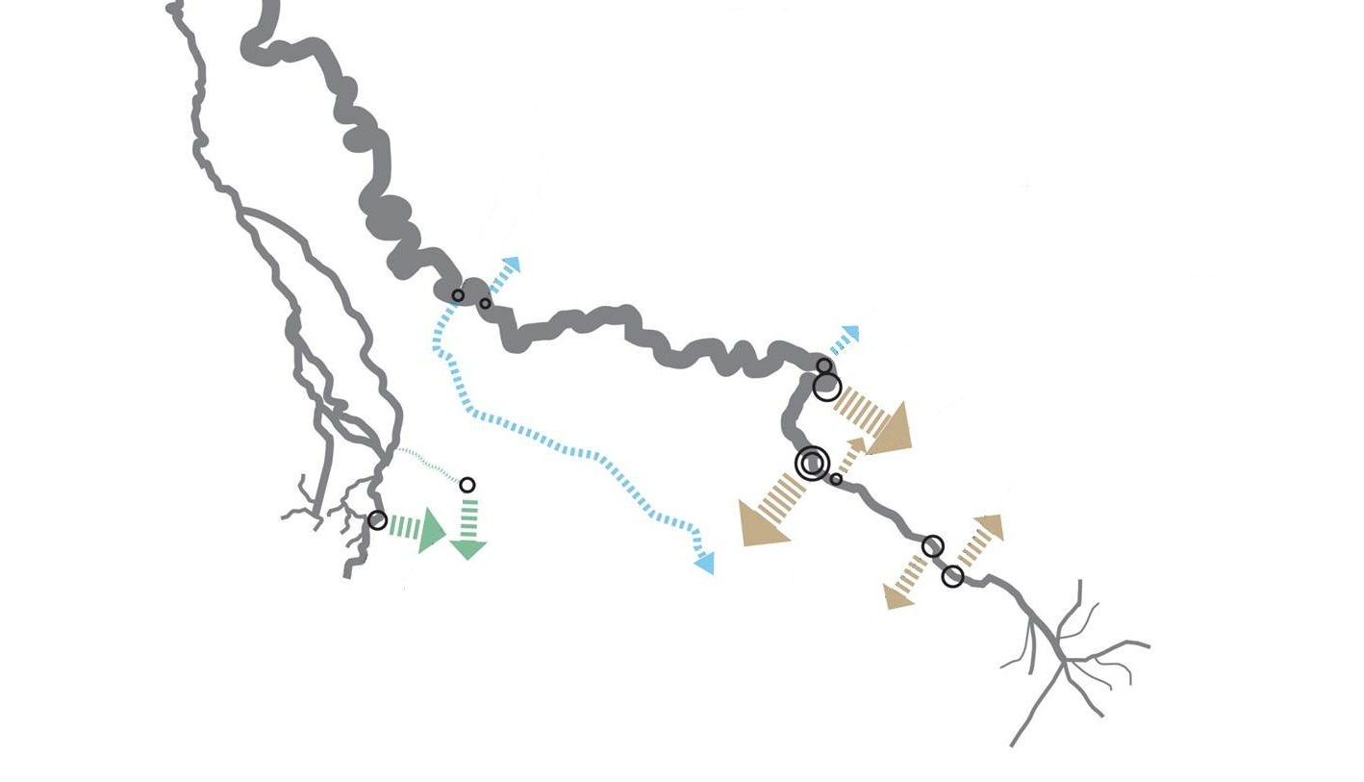

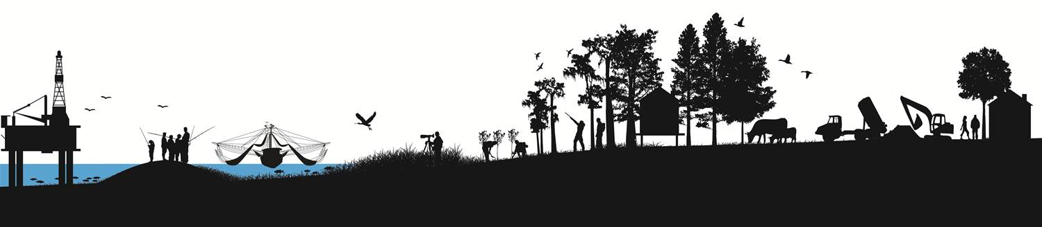
2012 Coastal Master Plan
Freshwater and Sediment Diversions
Mississippi Sediment Diversions
Freshwater Diversions
Atchafalaya Sediment Diversions

Slide 6
Recommendations
Data Driven - Monitoring, Success Criteria, and Adaptive Management
Predictive Tools- Development and Improvement
Public Coordination and Communication Considerations
Notes:
Themes in the Panel’s Report
Methods for biophysical data collection and dissemination
The need for collection and incorporation of social data
Models that should be developed and used as an ensemble
Coordination and Communication needs
Additional simulation and Experiments to be considered.

Slide 7
Recommendations
Data Driven - Monitoring, Success Criteria, and Adaptive Management
Notes:
Themes in the Panel’s Report
Methods for biophysical data collection and dissemination
The need for collection and incorporation of social data
Models that should be developed and used as an ensemble
Coordination and Communication needs
Additional simulation and Experiments to be considered.

Slide 8
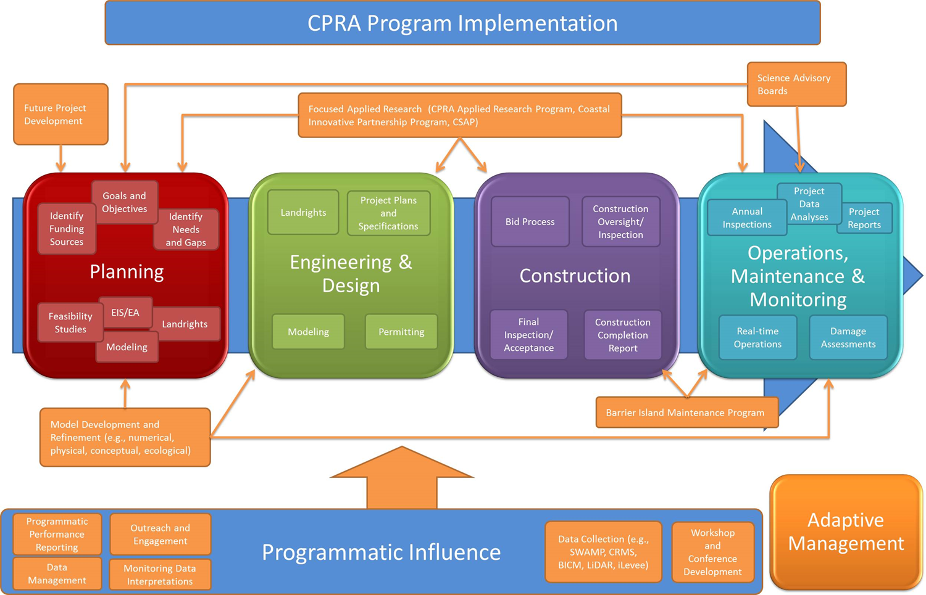

Slide 9

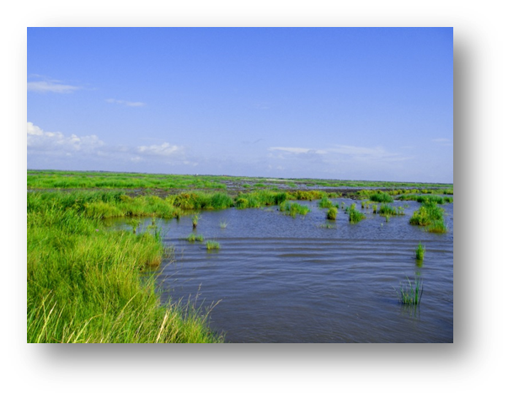
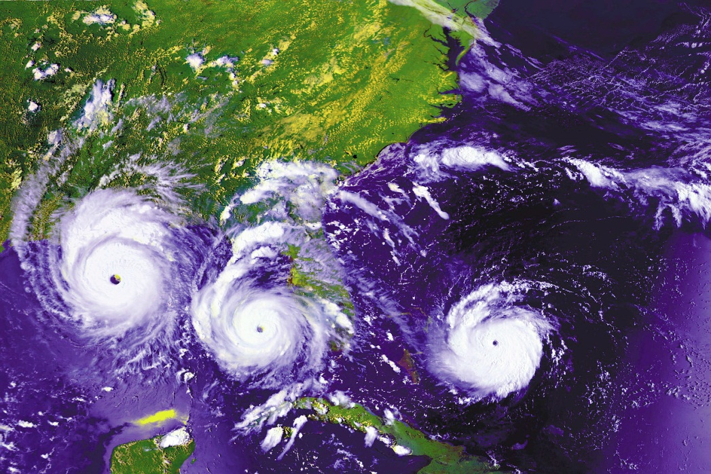
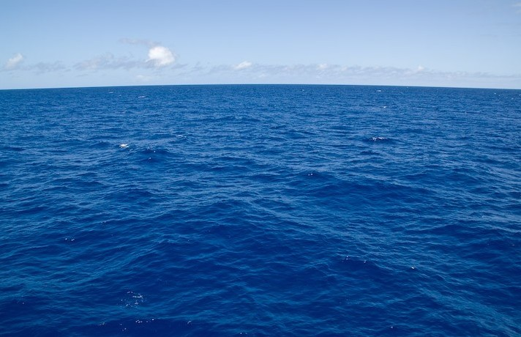
SWAMP
Met-data
Fish and Wildlife
Elevation
Geology
Vegetation Mapping
Landscape Change
Waters
Socio-economics
Protection Levels
Population Demo-graphics
Cultural Resources
Supporting Working Coast
Waves & Currents
Barrier Islands
Wetlands
Community Data
Environment Data
DRAFT

Slide 10
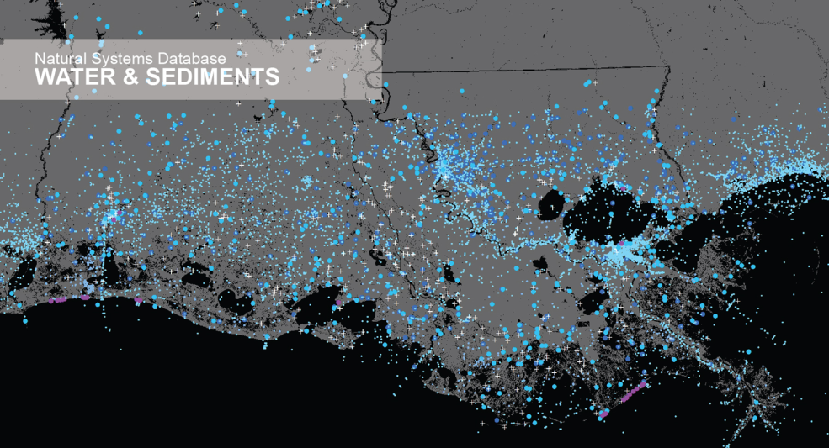
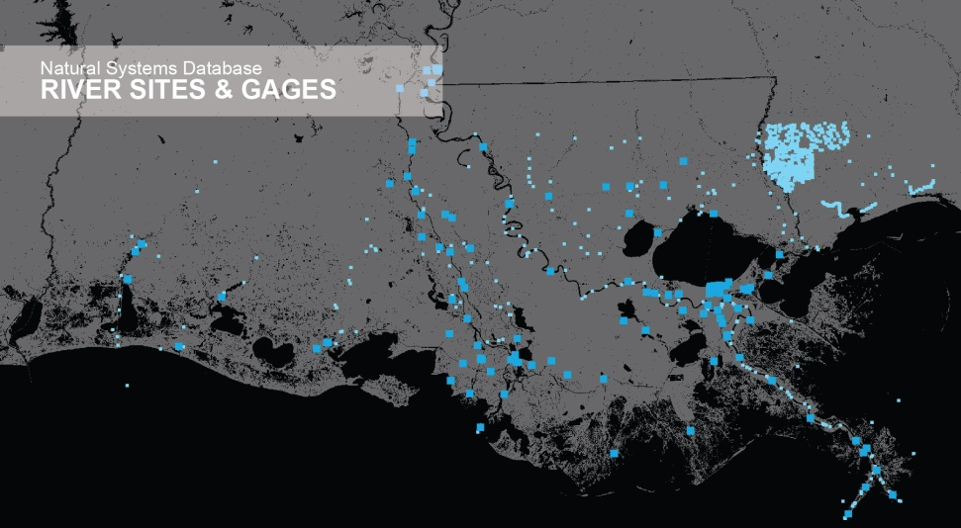
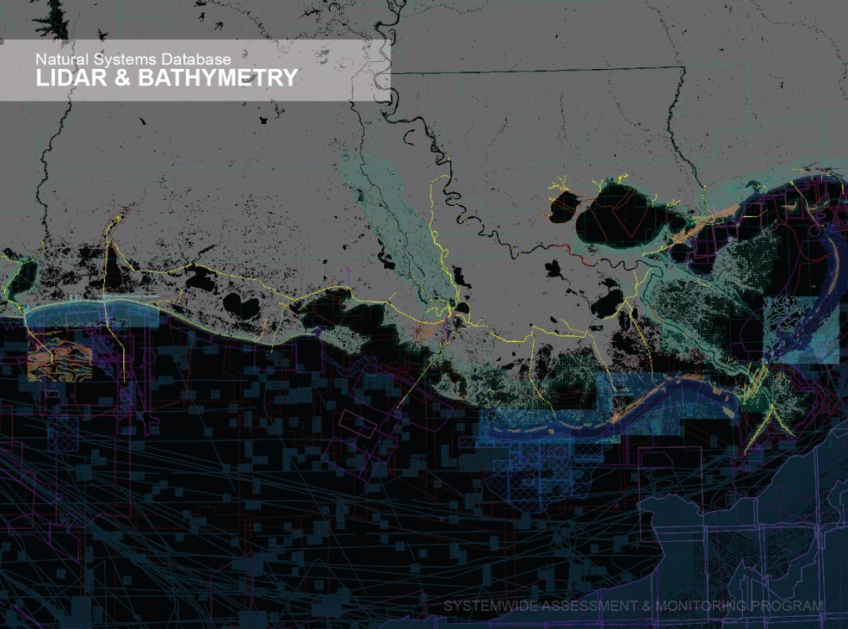
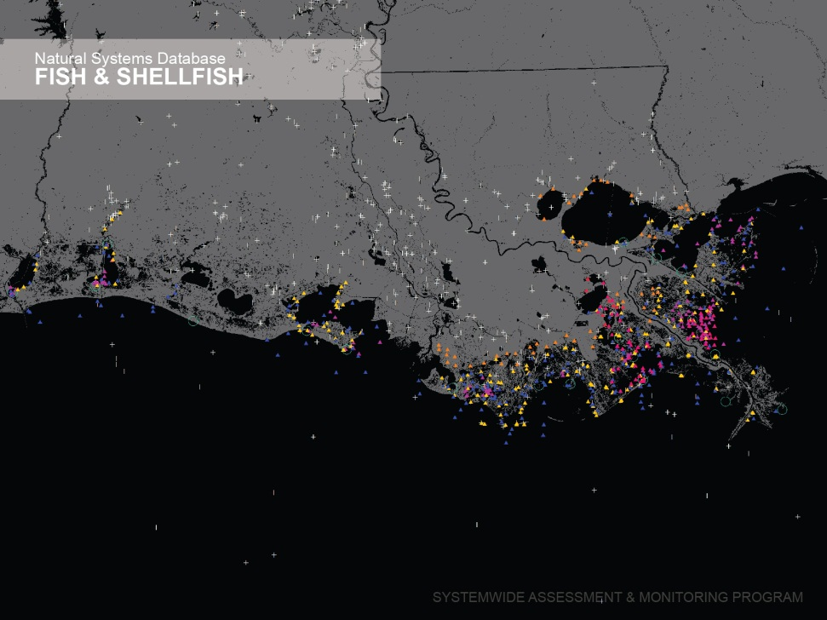
Data Inventory
Examples of Data Collected

Slide 11
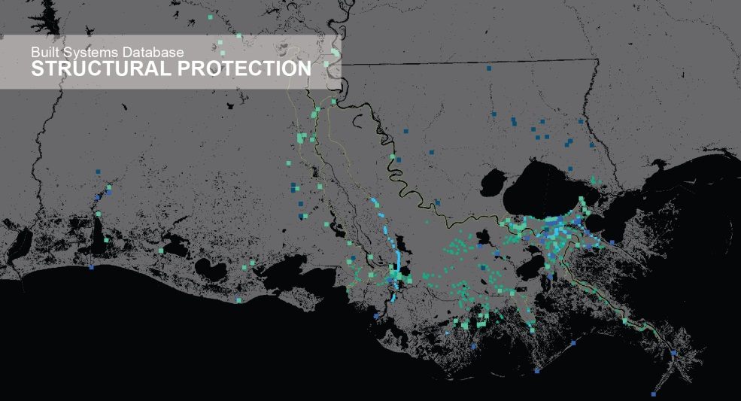
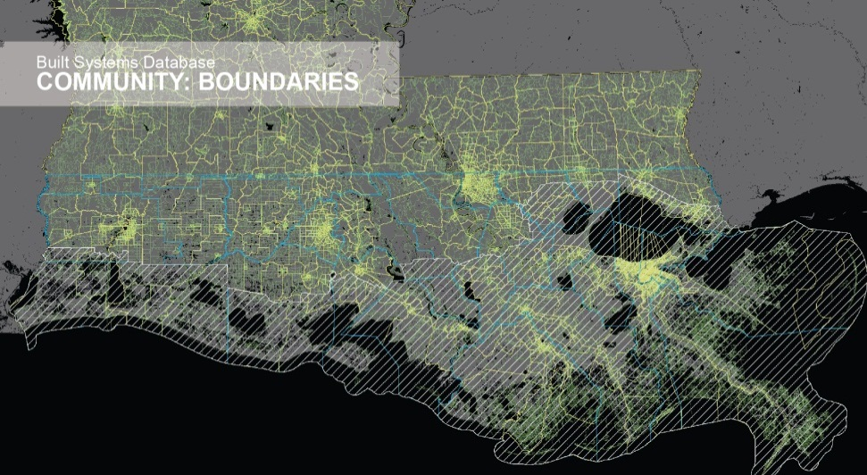
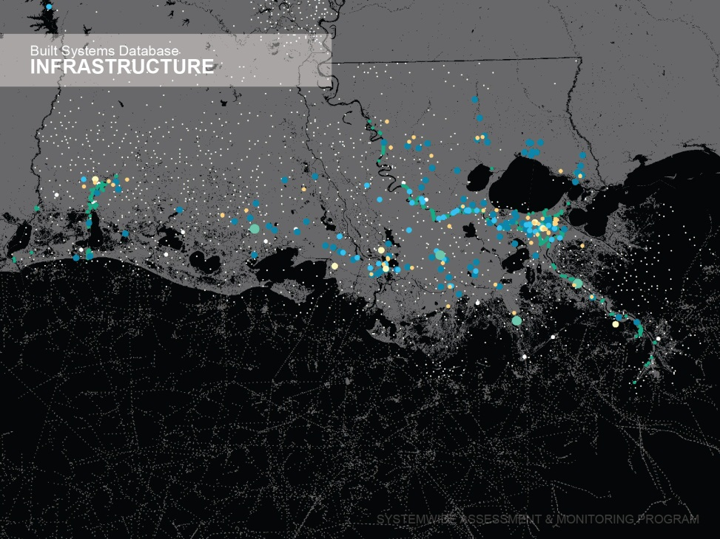
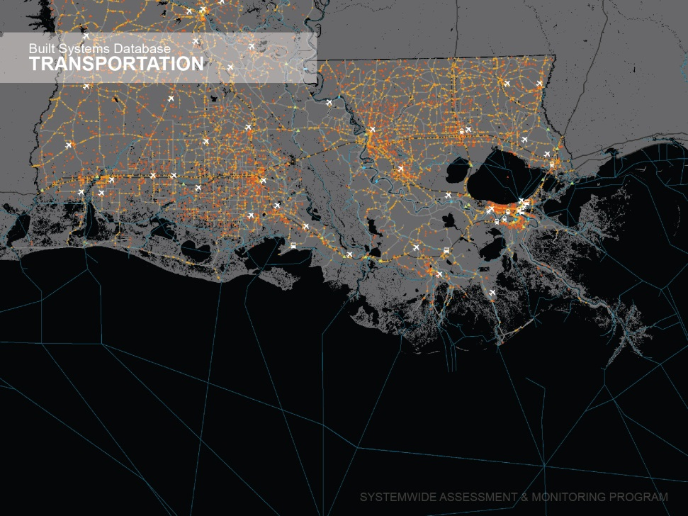
Data Inventory
Examples of Data Collected

Slide 12
Suggested Future Topics
Review Project Specific Data Collection
  Historic and Current Efforts
Review Suggested Monitoring Regime, Performance Metrics, Success Criteria, and Adaptive Management
Notes:
Themes in the Panel’s Report
Methods for biophysical data collection and dissemination
The need for collection and incorporation of social data
Models that should be developed and used as an ensemble
Coordination and Communication needs
Additional simulation and Experiments to be considered.

Slide 13
Recommendations
Predictive Tools- Development and Improvement
Notes:
Themes in the Panel’s Report
Methods for biophysical data collection and dissemination
The need for collection and incorporation of social data
Models that should be developed and used as an ensemble
Coordination and Communication needs
Additional simulation and Experiments to be considered.

Slide 14
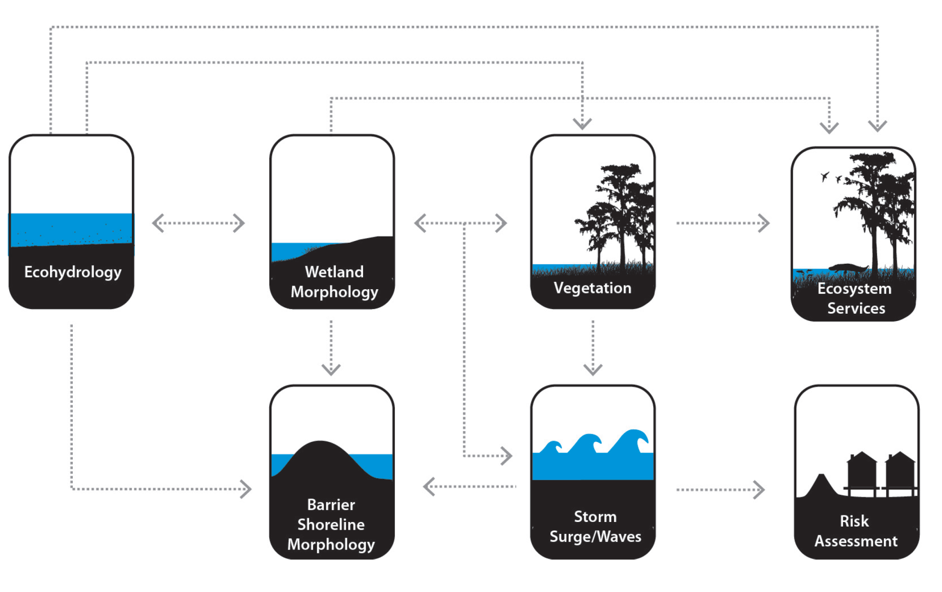
Coastwide Models- Master Plan

Slide 15
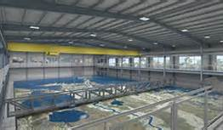
Regional Models
  Multi-Dimensional Models (ADH-SedLib, Delft 3D, FVCOM and Flow3D)
  Salinity patterns, Changes in vegetation/ habitat types,
  Water level fluctuations,
  Water quality and nutrients,
  Water temperature variability,
  Fisheries abundance and distribution

Slide 16
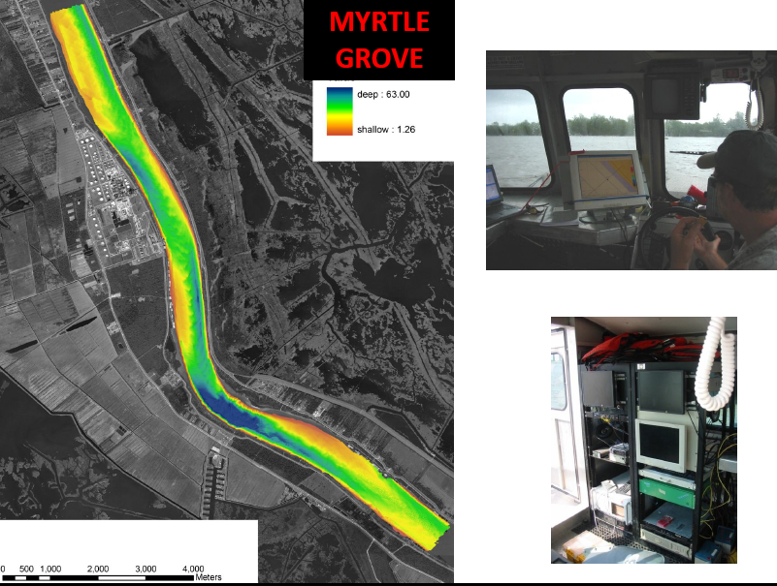
Project Specific Models

Slide 17
Suggested Future Topics
Regional Models
  Refined Diversion Array
  Potential Analogs
  Suggested Operations Regimes
Project Specific Analysis
Notes:
Themes in the Panel’s Report
Methods for biophysical data collection and dissemination
The need for collection and incorporation of social data
Models that should be developed and used as an ensemble
Coordination and Communication needs
Additional simulation and Experiments to be considered.

Slide 18
Recommendations
Public Coordination and Communication Considerations
Notes:
Themes in the Panel’s Report
Methods for biophysical data collection and dissemination
The need for collection and incorporation of social data
Models that should be developed and used as an ensemble
Coordination and Communication needs
Additional simulation and Experiments to be considered.

Slide 19
Public Coordination
Project/Program Development
    Public Meetings – CPRA, Diversion Expert Panel, Project Specific
    Education and Outreach
    Website- www.coastal.La.Gov
Operation of Project
    Technical Committee, Public Review of Operation Regime.
    Project Dashboards
Notes:
Themes in the Panel’s Report
Methods for biophysical data collection and dissemination
The need for collection and incorporation of social data
Models that should be developed and used as an ensemble
Coordination and Communication needs
Additional simulation and Experiments to be considered.

Slide 20
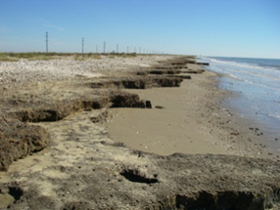
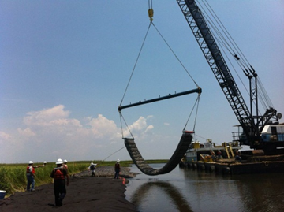
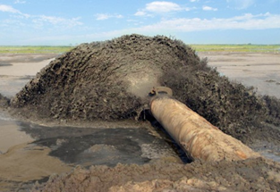
WWW.Coastal.LA.Gov
Thank You!
Kyle.Graham@LA.Gov

