Slide 1
Louisiana Coastal Area
Mississippi River Hydrodynamic and Delta Management Study
May, 2014

Slide 2
Mississippi River Suspended Sand Budget
2008-2010
100% Tarbert Landing
Above Baton Rouge overbank and channel storage
61%
Ostrica
Ft. St. Phillip
14%
Below Baton Rouge channel storage
Baptiste Collette
25% Belle Chasse
Grand Pass
West Bank Passes
West Bay
2%
5%
East Bank Passes
12%
Channel Storage
3%
HoP
SW Pass
SW Pass 2%
0.3% Pass a Loutre
South Pass
0.3%
Allison et al., 2012

Slide 3
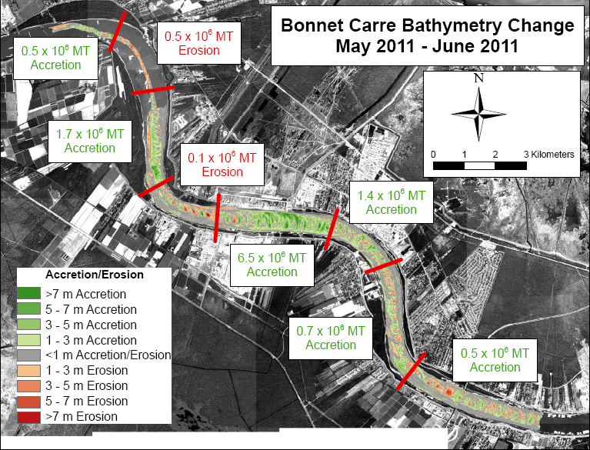
Mead Allison, University of Texas
Notes:
Bars above top of bars erode, toes deposit opposite afterwards. Reset themselves in an equilibrium location.
9.1 million million tons
Some accretion areas greater than 7 meters. Implications for navigations.
Gray areas of limited change.
Alternating patterns of red and green is cshifting dunes

Slide 4
Objectives of the Mississippi River Hydrodynamic Study
“The Mississippi River Hydrodynamic Study (MRH) will provide data and models to represent the existing Mississippi River below the Old River Control Structure (ORCS) is necessary to properly assess the operation and parameters of the Mississippi River & Tributaries (MR&T) system with respect to the available fresh water, nutrients and sediment transported by the river system, while considering the requirements for flood control and navigation along the river. The Mississippi River Hydrodynamic Study area encompasses the Mississippi River from the ORCS to the Gulf of Mexico.”
This part of the Mississippi River Hydro and Delta Management Project has been included in the “Watershed Studies” component of planning studies and not subject to “3x3x3”

Slide 5
Questions to be Addressed:
The Hydro team held a workshop over 3 years ago and articulated over 100 questions that needed to be addressed in order to understand the effects of diversions and other restoration projects on the main stem of the Mississippi River. These can be broadly grouped as:
Questions about the spatial and temporal availability of water and sediment resources and their movement through the system; and
Questions about how the removal of water and sediment will effect the sustainability of the river channel and the resources required to maintain the multiple uses of the river under projected future conditions such as climate change and channel modification.

Slide 6
Overall Project Structure
Task 1: Geomorphic Assessment
Task 2: Data Collection and Analysis
Task 3: Definition of Metrics for Assessing Model Predictive Skill
Task 4: Data Management
Task 5: One-Dimensional Modeling
Task 6: Multi-dimensional Modeling
Each team is co-lead by a State and Federal representative and coordinated by “Technical Leads”

Slide 7
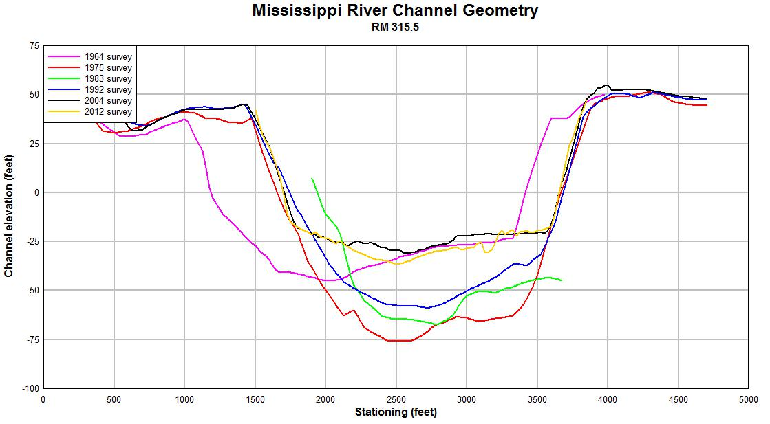
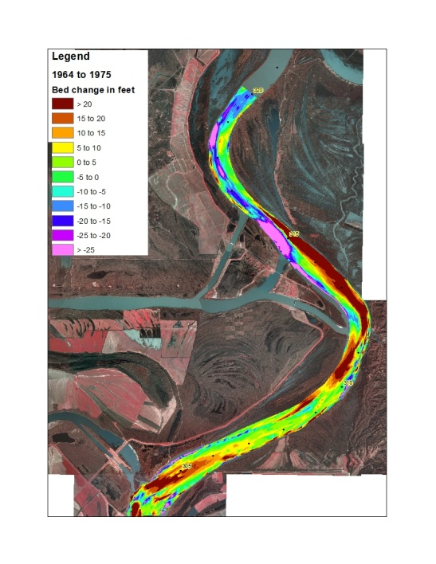
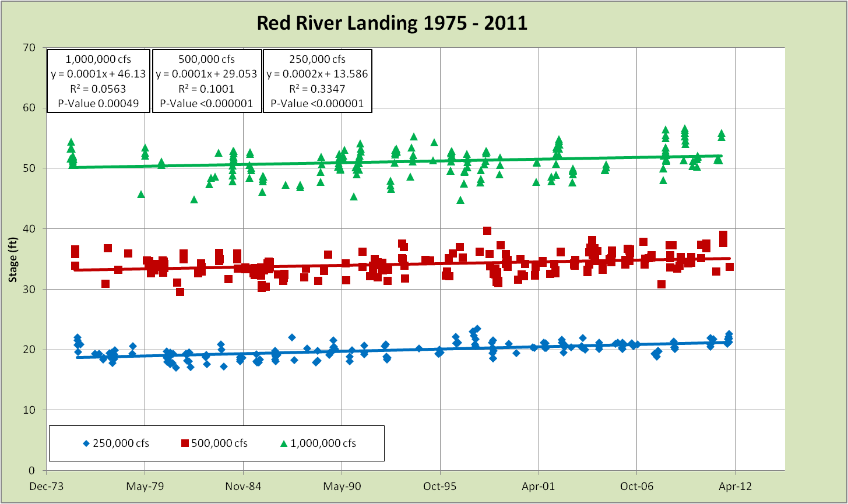
Task 1. Geomorphic Assessment
Data Compilation
Geometric Data Analysis
Gage and Discharge Analysis
Analysis of Dredge Records
Suspended Sediment Analysis
Bed Material Analysis
Event Timeline Analysis
Integration
Notes:
Team Leaders: Little (ERDC) and Biedenharn (CPRA)
Team Participants: CPRA, MVN
The overall objective is to utilize all available data to document historical trends in hydrology, sedimentation and channel geometry in the lower Mississippi River and to summarize the local changes observed at locations where repetitive datasets exist and at key reaches. The assessment will focus on but not be limited to the time period 1960 to the present.

Slide 8
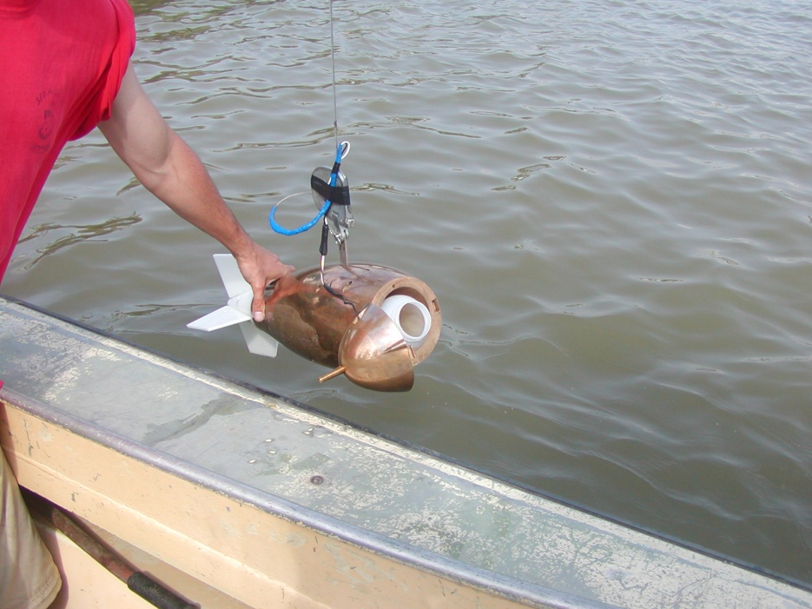
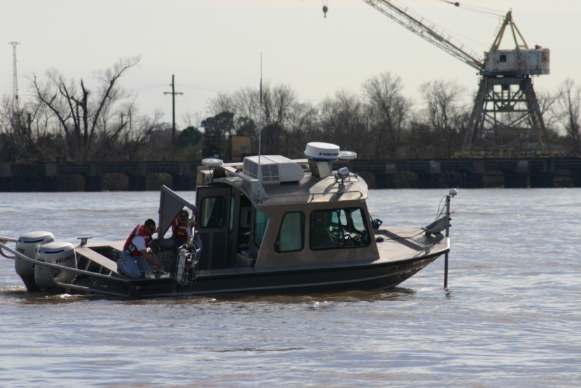
Task 2: Data Collection and Analysis
The overall objective is to utilize existing data and to collect and analyze new data to enhance the understanding of hydrodynamic and sediment processes in the lower MS River in order to support numerical modeling efforts
Objective 1: Trace a suspended sediment “pulse” through the system from ORCC to the deepwater passes and account for the processes that add/subtract from the water discharge and to/from the concentration and grain size composition of the suspended sediment.
Objective 2: Evaluate downstream transport of sand on lateral and point-bars in the lower river by assessing dune migration
Objective 3: Evaluate the complex behavior of water, sediment and nutrients in the Ostrica (RM24) to deepwater pass mouth(s) estuarine reach which experiences salt wedge penetration

Slide 9
Task 3: Definition of Metrics for Assessing Model Predictive Skill
Overall objective was to develop metrics to assess the predictive performance of the one and multi-dimensional models applied in this study. Separate metrics will be developed for each model type used in the study. The metrics will serve as a quantitative and unified tool to assess the models predictive performance.

Slide 10
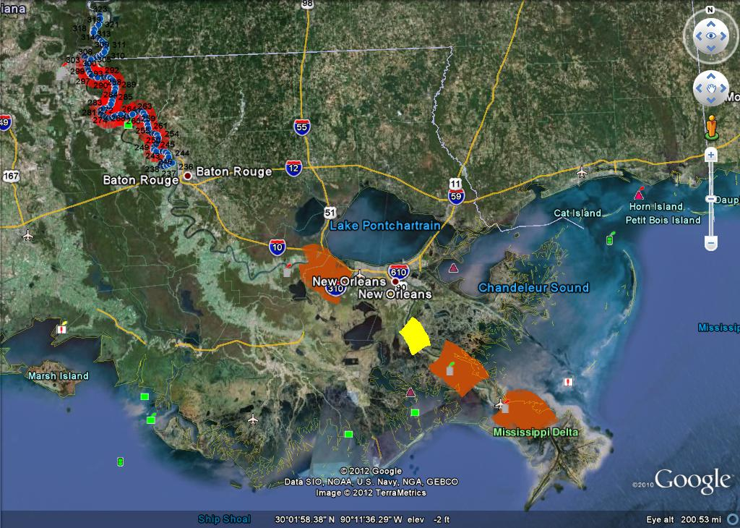
Task 4:Data Management

Slide 11
Tasks 5 and 6: One- and Multi- Dimensional Modeling
Objectives:
Develop tools for the Lower Mississippi River to:
Understand the existing conditions
Evaluate FWOA
Assess the cumulative impacts of implementing restoration projects on authorized activities such as navigation and dredging
Challenges:
Wide range of temporal and spatial scales of relevant physical processes
Complex water-sediment dynamics in the LMR
Complex coordination required among multi uses

Slide 12
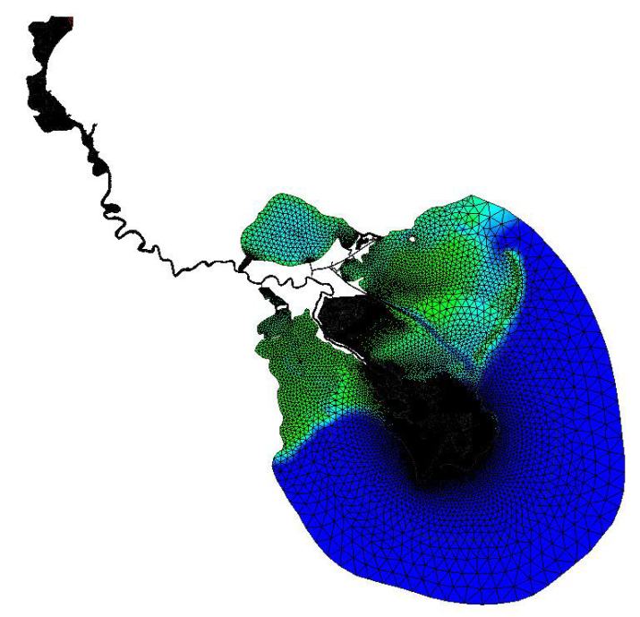
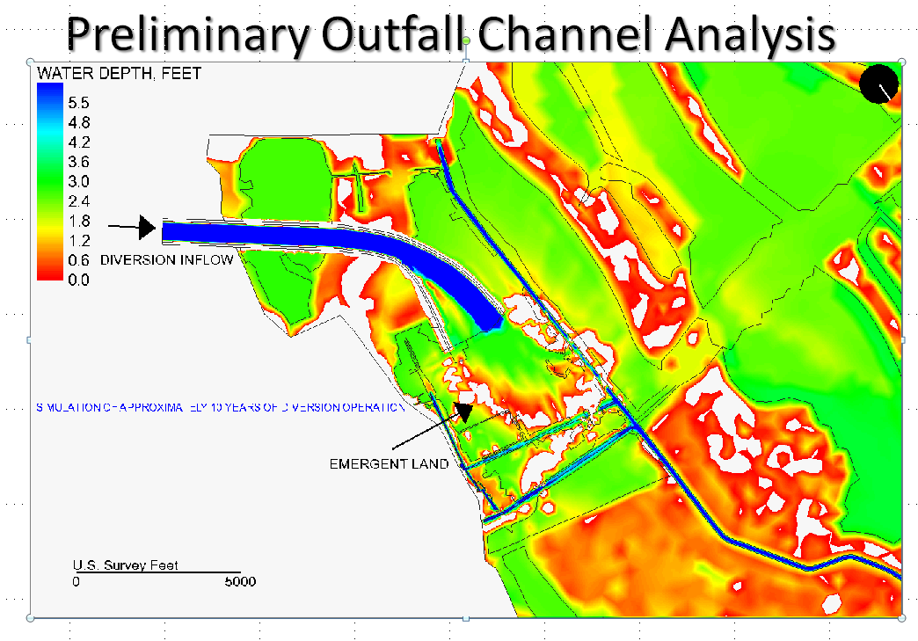
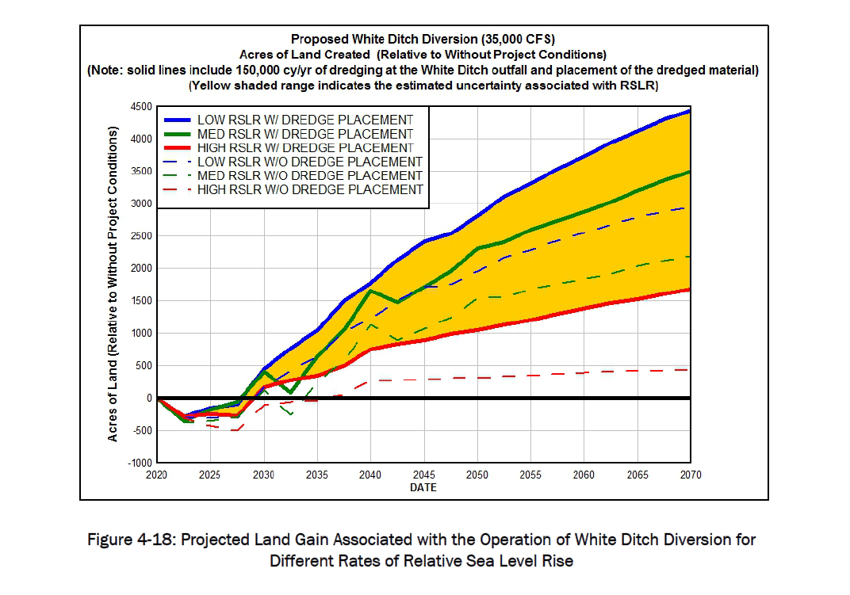
MS River Delta Management

