Slide 1
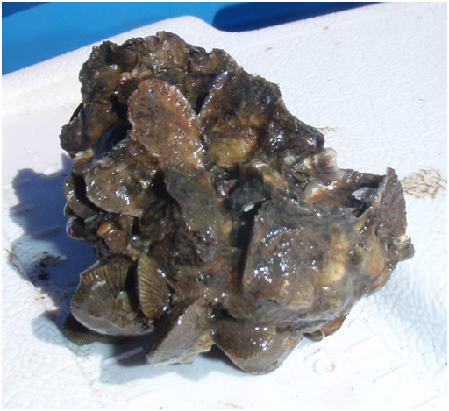
Sediment diversions and oyster challenges
Timing, duration and frequency of low salinity affect:
Oyster survival, recruitment, population structure
Habitat availability through effects on population structure (dS/dT > 0)
Sediment and nutrient loads have unknown effects on:
Food quality, food quantity
Oyster feeding and respiration rates
Habitat availability through physical habitat alteration
Studies
Field and lab studies on size-class tolerances to salinity and sediment load effects; effects on feeding rates, respiration, survival & resulting population structure
Use results of field and lab studies and DEB, and population level models to model effects of variable sediment diversion operating schemes on
oyster survival, recruitment; resulting population structure
recovery potential from “bad” years; population maintenance
habitat availability (shell resources); dS/dT ≥ 0
Understand estuary metapopulation dynamics: locations of source populations & capacity for adaptation
Examine alternate locations for leases, aquaculture sites using carrying capacity models, DEB modeling, coupled with hydrodynamic models
Temperature
Salinity
Oyster survival, recruitment and production & habitat availability
Food
Substrate
Flow
Sedimentation
Notes:
challenges

Slide 2
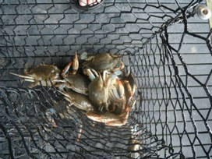
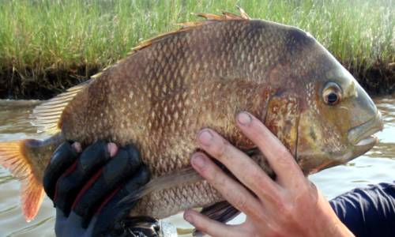
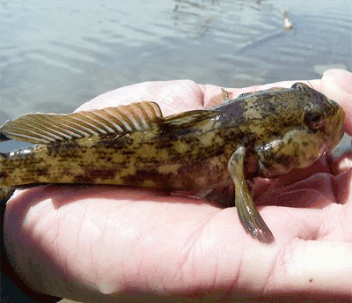
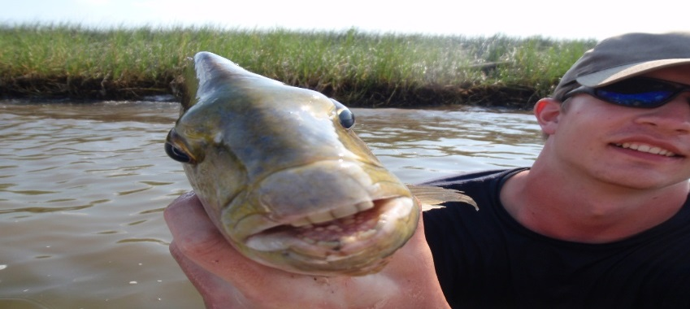
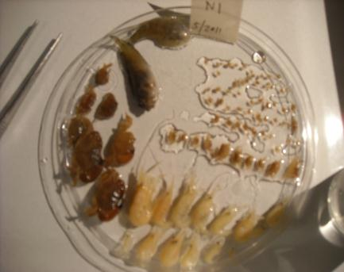
Sediment diversions and fisheries challenges
Changes in physical habitat attributes (marsh:land ratio and configurations, oyster reef habitat, SAV…) affect:
Nekton community assemblages
Availability & accessibility of habitat to meet individual species habitat needs
Changes in water quality may alter system-level production:
Effects on trophic transfer, trophic relay, trophic cascades
Affect consumer resource availability
Effects and relative importance of bottom-up controls vs. physical habitat alteration
Studies
Effects and relative importance of bottom-up controls vs. physical habitat alteration on system production
Field and manipulative experiments to understand effects of water quality changes (turbidity, nutrients) on trophic transfer or energy flow within communities including between nekton consumers and invertebrate prey (trophic relay: water - vascular plants - microbes – invertebrates – resident fish – pelagic fish)
Analyses of short-term & long-term data, use & continual testing of models to understand operation of diversion (timing, duration, intensity and frequency) and effects on bottom-up controls
Notes:
2

