Slide 1


Wildlife and Fisheries Responses to Existing Freshwater Diversions
David Lindquist
Planning and Research Division
April 30, 2014
committed to our coast
committed to our coast

Slide 2
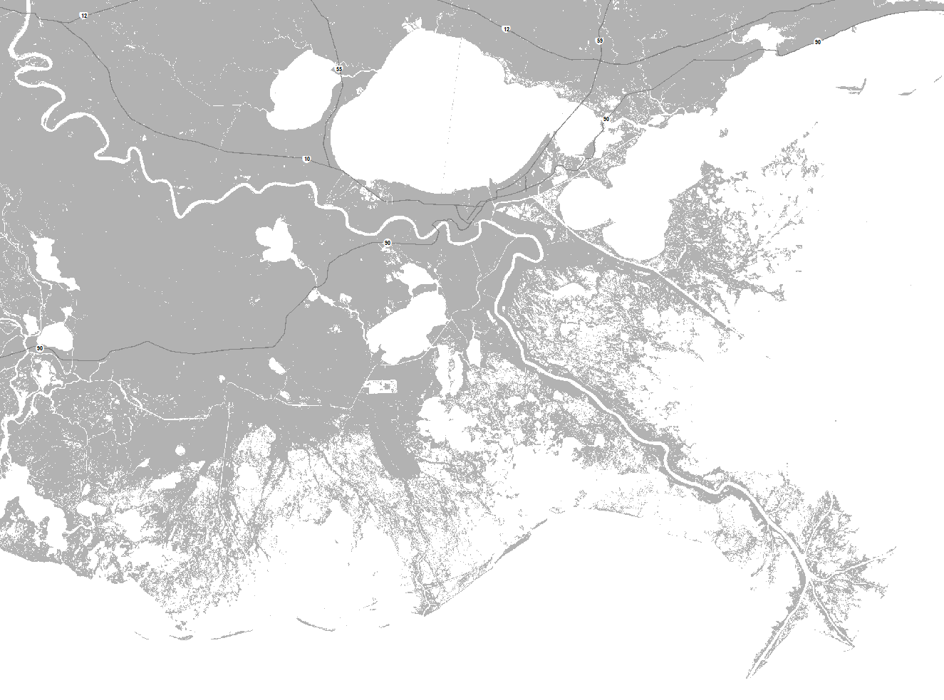
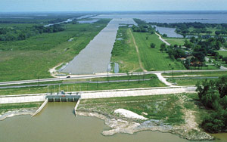
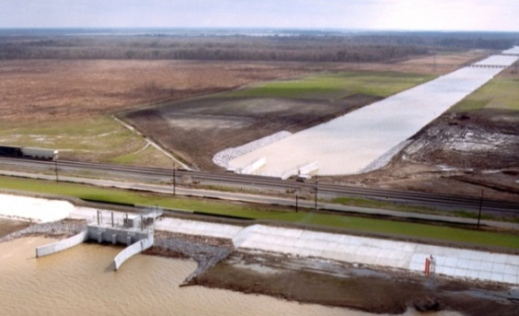
Freshwater Diversions
Baton Rouge
Lake Maurepas
Lake Pontchartrain
LaPlace
New Orleans
Lake Borgne
Lac Des Allemands
Caernarvon Freshwater Diversion
Opened: August 1991
Max. Flow: 8,000 cfs
Basin: Breton Sound
Lake Cataouatche
Davis Pond Freshwater Diversion
Opened: July 2002
Max. Flow: 10,650 cfs
Basin: Barataria
Lake Lery
Lake Salvador
Lafitte
Breton Sound
Little Lake
Barataria Bay
Gulf of Mexico
Venice
Terrebonne Bay
Grand Isle
Existing Diversions, Siphons, Crevasses

Slide 3
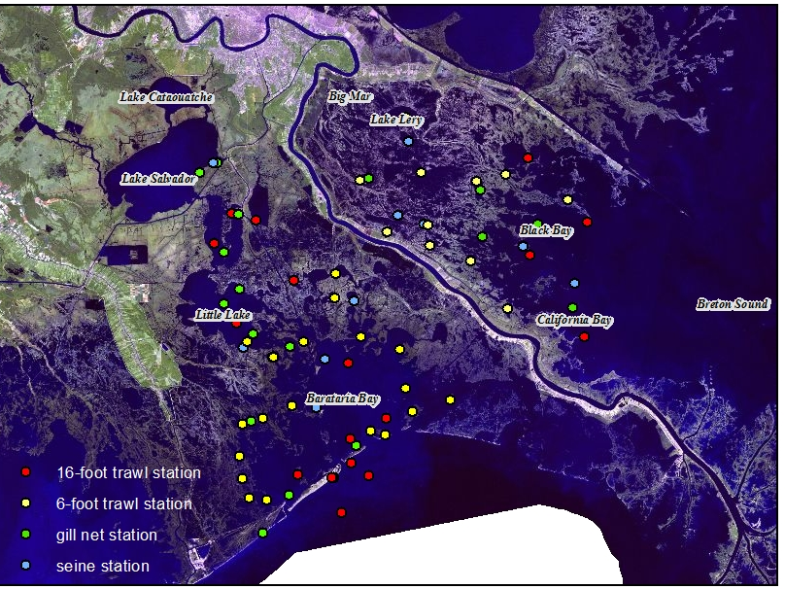
LDWF Wildlife and Fisheries Monitoring
Monitoring relative to diversions began:
  1988 in Breton Sound estuary
  1998 in Barataria estuary
Marine Finfish and Shrimp sampling occurs along the salinity gradient using a variety of gear types
Freshwater Finfish sampling in upper basins
Oyster monitoring (locations not shown)
  Black Bay/California Bay in Breton Sound
  Upper Barataria Bay
Aerial surveys for alligator nests and ducks
Notes:
*Marine finfish and shrimp gears include: 6- and 16-foot trawls, seines, experimental gill nets, trammel nets, etc.

Slide 4
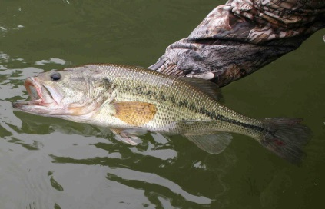
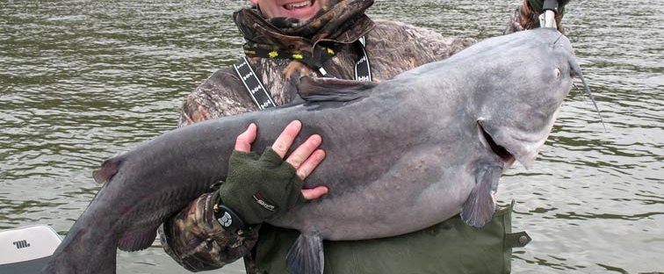
Salinity-related Changes
Large number of studies focused on impacts of salinity changes (Breton Sound estuary most studied)
Since the diversion opened, increased abundance and distribution of freshwater species in upper basins
  Largemouth bass, sunfishes, catfishes, etc.
Decreased numbers of some transient coastal species
  Spanish mackerel, Florida pompano
Largemouth bass
Blue catfish
Annual aerial surveys of alligator nests by LDWF
Counts of nests have increased by 243% in Breton Sound estuary
Corresponds to increased acreage of preferred fresh/intermediate marsh habitats
Diversion Open
(Data from LDWF sampling in Breton Sound)
Notes:
*Emphasize that results shown in this presentation are from studies in Breton Sound assessing effects of Caernarvon.
*The transient marine species typically only utilize the lower estuary and do not comprise a significant portion of community.

Slide 5
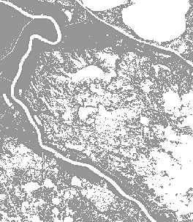
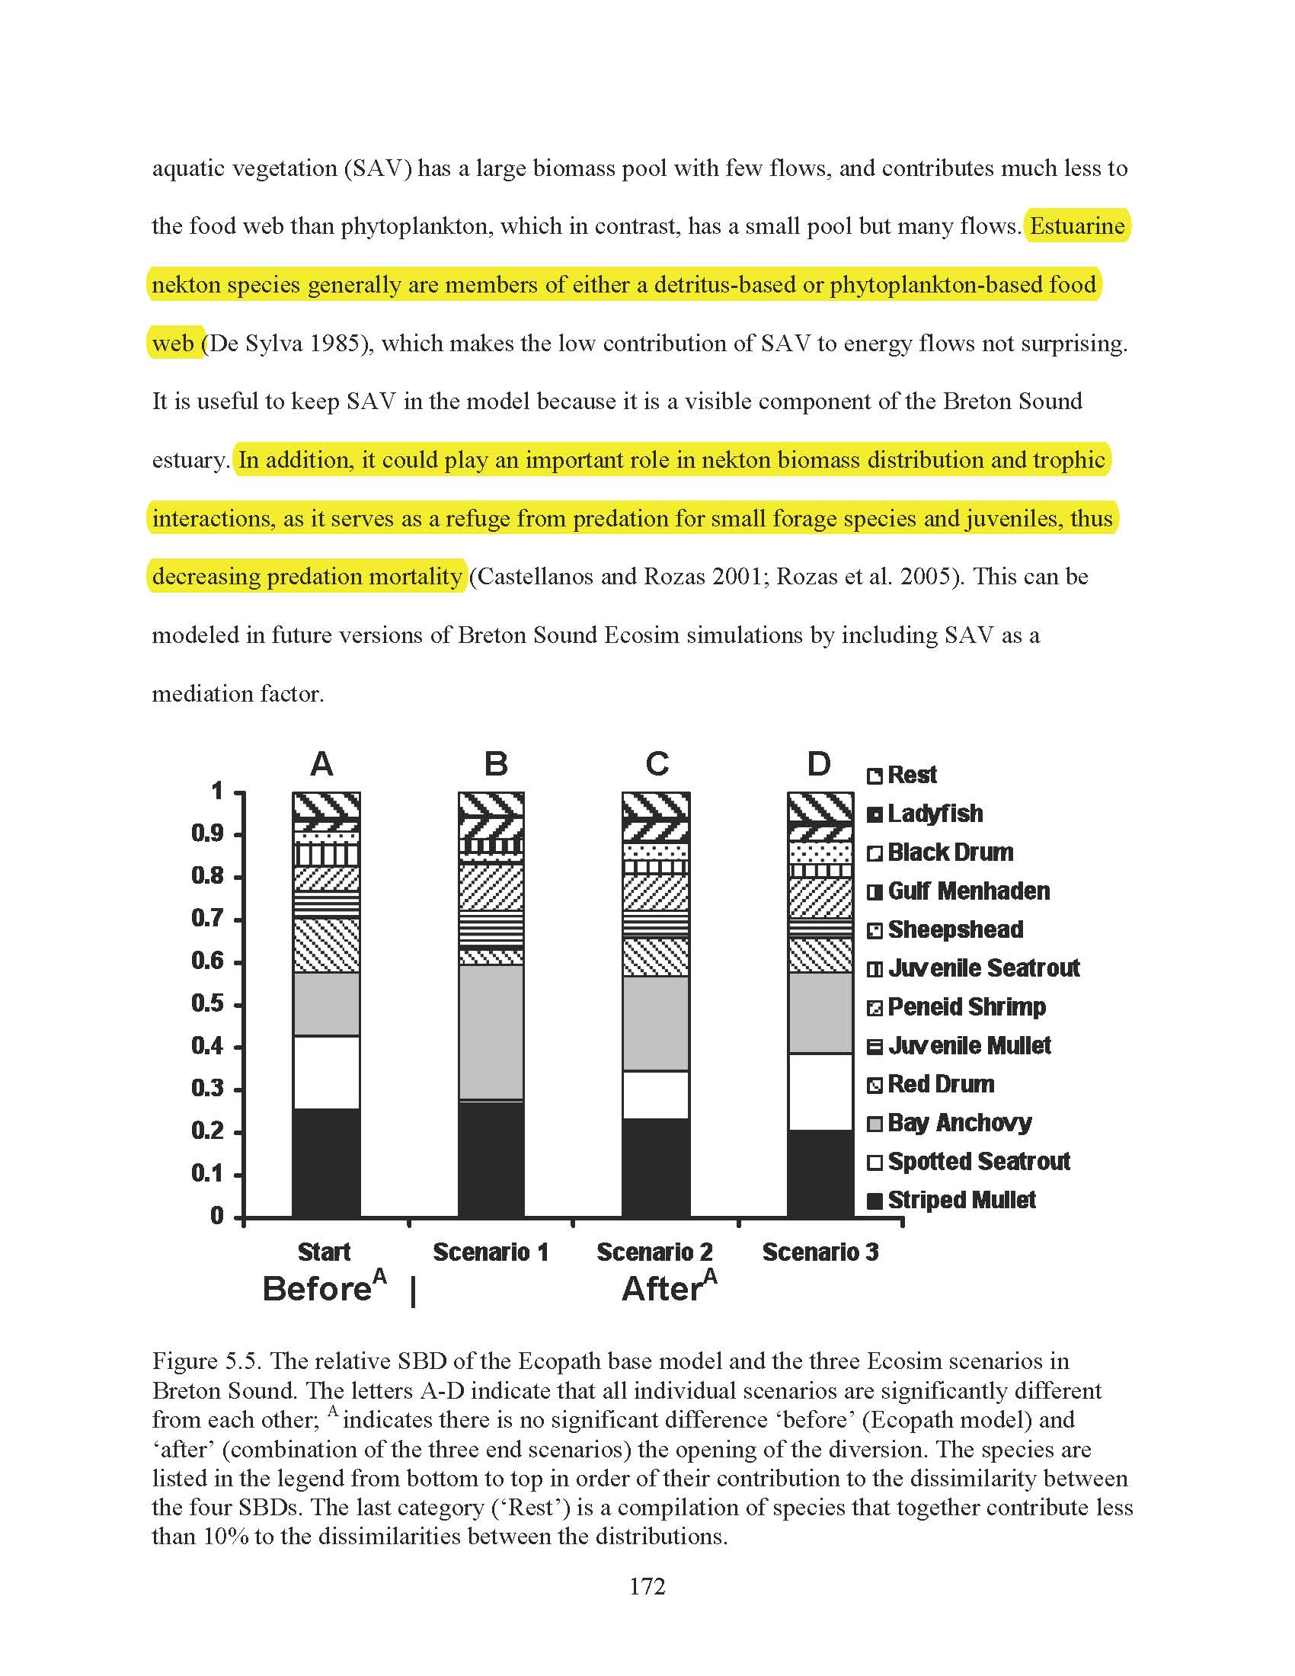
Otherwise, changes in community structure related to the redistribution of species within the estuary
Most evident after high-flow pulses of diversion
  Observed in field data
  Individual-based fish movement modeling
Displacement likely temporary – evidence that brown shrimp moved back up-estuary after pulse


The effect of salinity changes on Breton Sound fish and shellfish communities was modeled by de Mutsert (2010) using Ecopath with Ecosim (EwE).
Model simulated three salinity regimes (low salinity = Scenario 1, medium = 2, high = 3) on baseline community (= Start). Scenarios analogous to position in estuary.
Each scenario produced a significantly different community.
When scenarios combined the community not different from baseline. This suggests that freshwater inflow from the diversion results in redistribution rather than removal from the estuary.
From: de Mutsert (2010)
Notes:
*Rozas et al. stable isotope analysis suggested that brown shrimp collected in mid-basin after pulse were recently feeding in the lower estuary.
*De Mutsert used five years of LDWF seine data from before Caernarvon opened to construct a “baseline” community.
This “baseline” community was used to test the effects of three salinity scenarios. Salinity measurements for these scenarios came from data collected at three distances from the diversion, so each scenario is analogous to spatial position within the estuary.
The results of these simulations are shown (each scenario significantly different). Species represented as percent of total system biomass.
Anchovy and mullet more prevalent in lower salinity scenarios, speckled trout more prevalent in higher salinity scenario.
When all three scenarios are combined the resulting community was not different from “baseline”. Thus Breton Sound community as a whole is generally unchanged, species just redistribute.

Slide 6
Brown Shrimp and White Shrimp – Fisheries Independent Data
Brown Shrimp
Larvae move into estuaries late winter/spring, reported to prefer higher salinities
Thus, concerns that increased freshwater inflow may impact populations
No apparent decline in catch over time
Studies have shown that distributions rarely correlated with salinity
(From LDWF sampling in Breton Sound; 2010 dataset incomplete)
White Shrimp
Larvae move into estuaries late spring/summer, frequently utilize lower salinities
White shrimp dominated landings through 1940s
Catch seems to have increased over time
Distributions also rarely correlated with salinity
(From LDWF sampling in Breton Sound; 2010 dataset incomplete)
Notes:
*Brown shrimp catches relatively high despite higher spring-time flows in 2008 and 2010.
*2010 datasets for both species incomplete (missing last 4-5 months), so brown shrimp CPUE will likely decrease some whereas white shrimp CPUE will likely increase some.
*White shrimp comprised 95% of the catch (Condrey and Fuller 1992), but when inflow from Miss. River was curtailed commercial catch became dominated by brown shrimp.
*Because shrimp larvae (and other species as well) originate from offshore spawning, patterns of abundance may also be dependent on factors on shelf (winds, currents, etc.) that affect larval movement and dispersal. That is, above patterns not solely reflecting conditions within estuary.

Slide 7
Eastern Oyster
Caernarvon Diversion constructed to help increase oyster productivity by decreasing salinities, thus reducing diseases and predation
LDWF monitors seed- and sack-size oysters in meter-square plots on public grounds, also conducts boarding surveys of oyster dredgers
Production shifted eastward with mortality at upper-estuary reefs and rehabilitation of lower-estuary reefs
Oyster productivity increased substantially following opening of Caernarvon Diversion
Unclear just how much of trends due to diversions
  LDWF Monitoring stations also receive flow from Mississippi River Delta
  Being sessile, oysters affected by additional factors such as harvest pressure, storms, substrate availability
(Data from LDWF sampling in Breton Sound)
Notes:
*LDWF monitors number of seed- and sack-size oysters in meter-square plots. Also, assesses harvest by boarding oyster dredges and estimating oysters collected.
*Oysters generally most productive between 5 and 15 ppt (lower end because of physiological tolerances; upper end because of predators (drill) and diseases (Dermo)). This zone shifted down-estuary once diversion opened.
*Decrease in seed- and sack-size oysters from meter-squares around 2002 unclear, does not correspond to any flooding/low-salinity event(s).
*Fact that oysters sessile and thus affected by other factors complicates interpretation of data.

Slide 8
Speckled Trout
Preference for higher salinities, could be affected by increased freshwater inflow
CPUE from gill nets variable but generally steady over time
Post-diversion reductions in catches at upper-estuary locations observed, but catches at these sites were always low
(From LDWF sampling in Breton Sound; 2010 dataset incomplete)
Ecosystem modeling indicated a negative relationship between salinity and trout biomass
Trout still expected to occur at pre-diversion levels at higher-salinity end of estuary
Thus, increased freshwater inflow hasn’t affected overall distribution pattern
From: de Mutsert (2010)
Notes:
*1999-2000 peak due to drought conditions.
*Before diversion, speckled trout may have been a little more widespread but still most abundant in lower estuary.

Slide 9
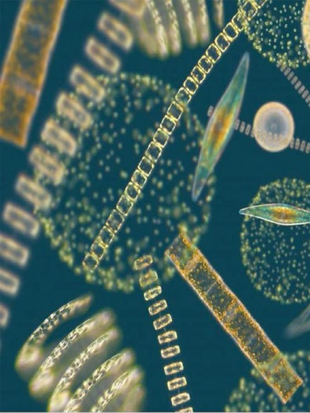
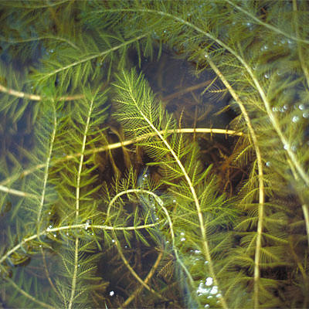
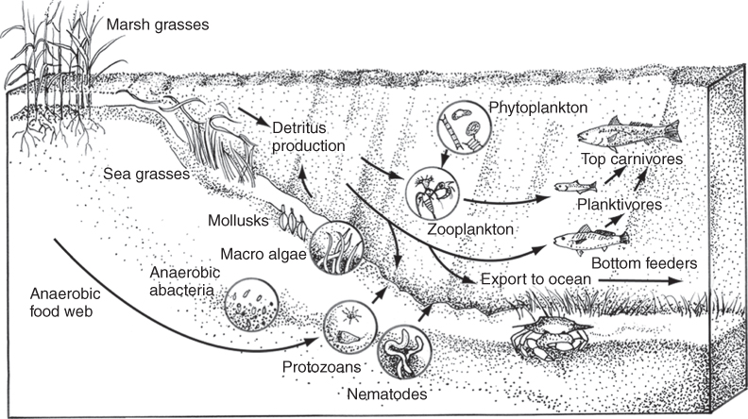
Food Web Interactions
Riverine inflow provides critical inputs of freshwater, nutrients, and sediment
These inputs have been shown to increase plant productivity (e.g. algae, phytoplankton, SAV, emergent vegetation)
Increased plant production should benefit the rest of the estuarine food web
Aquatic vegetation
Adapted from Day et al. (2013)
Notes:
*Discussion of effects of diversions on plant productivity, etc. is its own presentation. Couldn’t adequately cover the topic here.

Slide 10
Stable Isotopes
Stable isotopes analysis provides a means to determine the extent that riverine nutrients have influenced estuarine food webs.
Distinctive ratios of carbon, nitrogen, and sulfur isotopes occur in different estuarine source waters (riverine, marine, precipitation) and these can be used to identify the sources of energy that propagate through the food web.
Wissel and Fry (2005) analyzed isotopic ratios of grass shrimp, and plankton-feeders such as barnacles and anchovy (at left).
Ratios associated with diversion-delivered riverine water (=diversion in figure) were found along known flow-paths and during times of greatest diversion flow.
Diversion-delivered nutrients were responsible for 75% of the food web support in the upper basin, drops off to 25% in mid-estuary.
Clear that riverine nutrients delivered by diversion contribute a substantial amount to food web support
This analysis supports the belief that estuaries are nutrient sinks
From: Wissel and Fry (2005)
Notes:
*Wissel and Fry (2005) analyzed grass shrimp tissue (a benthic omnivore) and barnacle and anchovy (both planktivores). Barnacles and anchovy combined in the accompanying figure.
*Basically, isotopes associated with diversion flow were found where and when diversion flow occurred.
*Diversion-delivered nutrients are quickly assimilated into food web, as evidenced by the 75% to 25% drop-off.

Slide 11
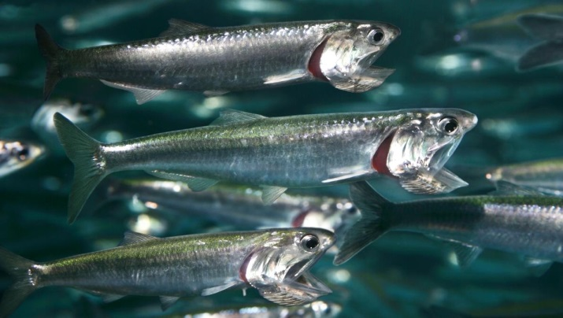
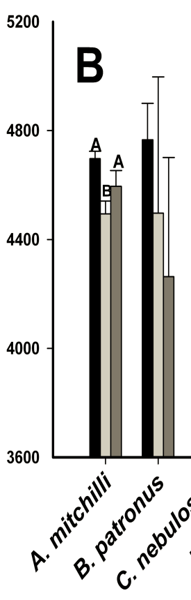
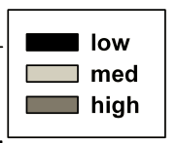
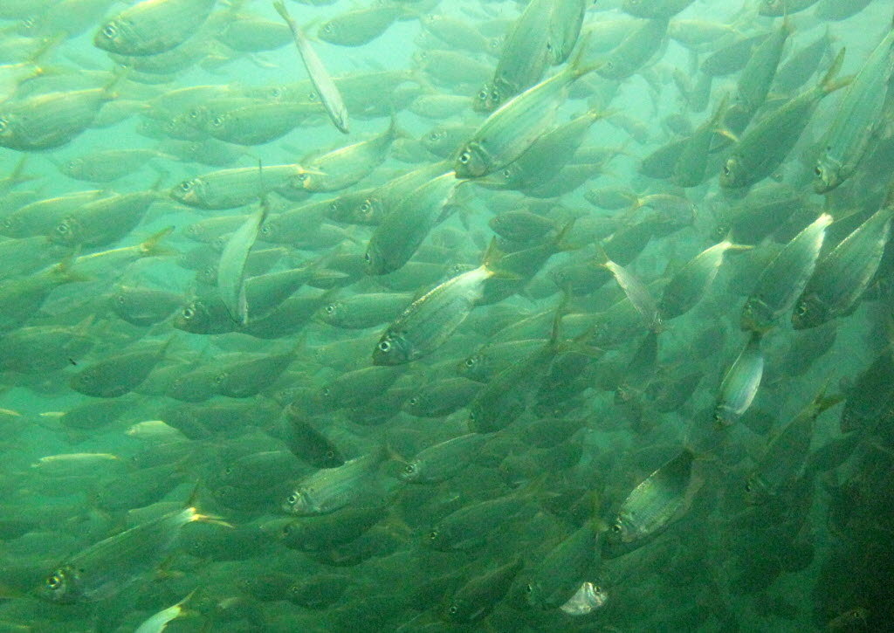

Trophic Linkages
Nutrient enrichment typically results in increased phytoplankton and zooplankton biomass, resulting in greater abundances of small, planktivorous fishes
Analyses from Breton Sound showed higher contribution of phytoplankton to food web in areas receiving greatest diversion flow
Bay anchovy
Higher caloric densities in these areas suggests that the quality of food resources available to consumers has improved
Greater numbers of planktivores have been collected in the basins since the diversions opened
Gulf menhaden
From: de Mutsert (2010)
Notes:
*These “Trophic Linkages” slides are meant to illustrate how riverine nutrients propagate through the food web and potentially increase productivity.
*In other areas of world, nutrient enrichment commonly means increased importance of the planktonic food web and pelagic community.
*Analyses by de Mutsert (2010 dissertation) backs this up, with phytoplankton being more important to food web in areas receiving diversion flow.
*Phytoplankton is a high-quality, energy-rich food source, so increase in phytoplankton = increase in food quality. De Mutsert analyses show bay anchovy and Gulf menhaden tissue had greater caloric content in areas closer to the diversion (legend is low, medium, and high salinity sites).

Slide 12
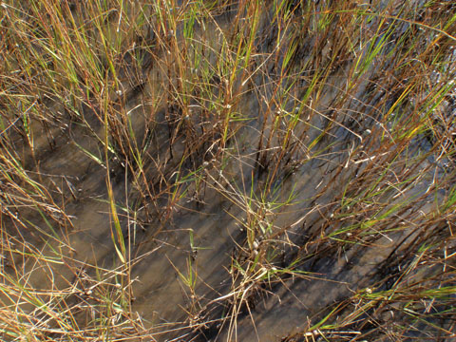
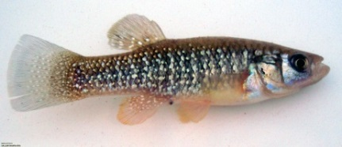
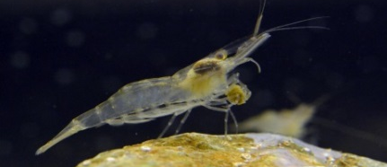
Trophic Linkages
Algae, detritus, and inverts associated with the marsh surface are important prey for a number of species.
Marsh surface also a refuge from predators
High-flow pulses from diversion increase marsh hydroperiod, allowing fish and shellfish to take greater advantage of this habitat
Greater numbers, biomasses, and growth rates of resident species (e.g., killifish, grass shrimp) observed in areas receiving pulses from Caernarvon Diversion
Piazza and La Peyre (2012) estimated that pulses increased production of residents by 60%
Same may apply to other species that use marsh surface (e.g., brown shrimp)
Notes:
*Diversion-delivered nutrients enhance productivity of emergent vegetation and epiphytic algae. This plant productivity augments food web directly through grazing, or indirectly through plant decomposition and enhancement of detrital pool.
*Resident species such as killifish or grass shrimp are major consumers of the above material as well as marsh surface inverts.
*Work by Piazza and Piazza and LaPeyre showed greater numbers, biomass, etc. of these residents.
*Brown shrimp use the marsh surface but primarily near the edge. Individual-based models by Roth et al. (2008) showed that greater marsh inundation resulted in greater growth and survival of brown shrimp.

Slide 13
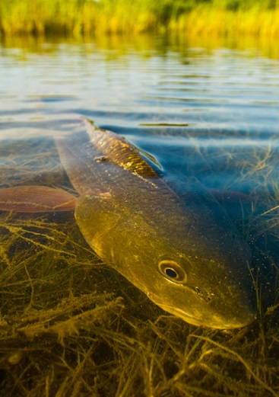
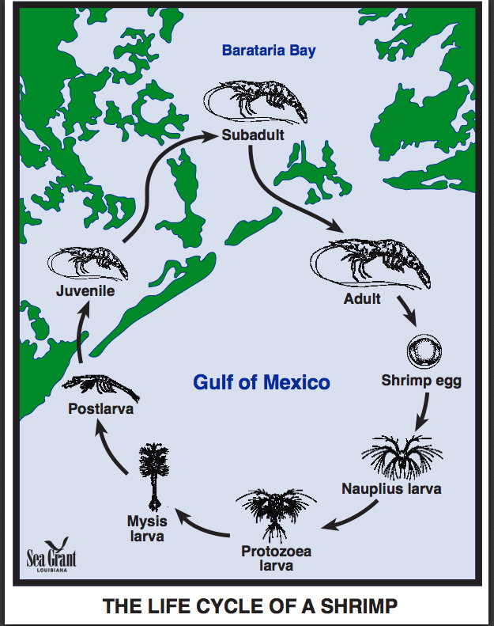
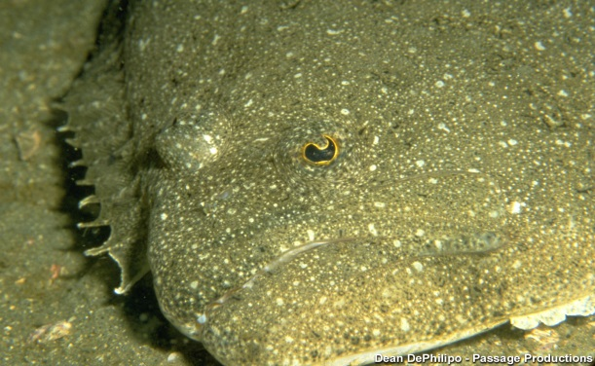
Trophic Linkages
Previous species are prey for higher-order consumers
Increased production of prey should increase production of predators
This hasn’t been directly investigated, but would be consistent with other ecosystems where “bottom-up” trophic effects occur
Due to life cycles, increased estuarine production may benefit adjacent coastal habitats
Also, increased nutrient assimilation by wetlands should help reduce size of the “Dead Zone” and subsequently benefit fisheries on shelf
Notes:
*”bottom-up” changes primarily at the lower trophic levels/prey base cause changes at upper trophic levels

Slide 14
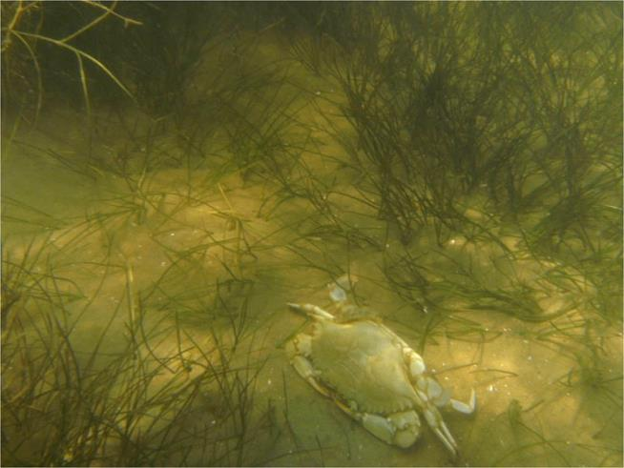
Nursery Function
Estuaries = productive nurseries because they provide abundant food and low predation pressure
Freshwater inflow from diversions may enhance nursery function
Inflow may displace predators with preference for higher salinities
  Explains larger biomass of anchovies, etc. in low-salinity model simulation?
Inflow may increase the availability of structurally-complex habitats, which reduces predator foraging efficiency
SAV has greatly increased in coverage due to inflow.
  In Breton Sound, SAV coverage greater in areas receiving inflow (66% vs. 18%, Rozas et al. 2005)
  SAV supported higher densities of fish and shellfish, including important fishery species
From: de Mutsert (2010)
Notes:
*Nurseries are habitats that provide abundant food and protection from predators such that these habitats contribute disproportionally to the production of recruits to adult populations.
*Freshwater inflow may enhance nursery function by increasing food resources (already discussed) and possibly by reducing predation pressure.
*De Mutsert model simulations showed greater amount of anchovies and other forage species such as mullet (and even penaeid shrimp) in the low-salinity scenario. Considering EwE is a “top-down” model where environmental conditions control predation/feeding rates and subsequently the abundance of prey, it is hypothesized that the larger amount of anchovies is due to displacement of predators.
*Structurally-complex habitats = the flooded marsh surface and beds of SAV.

Slide 15
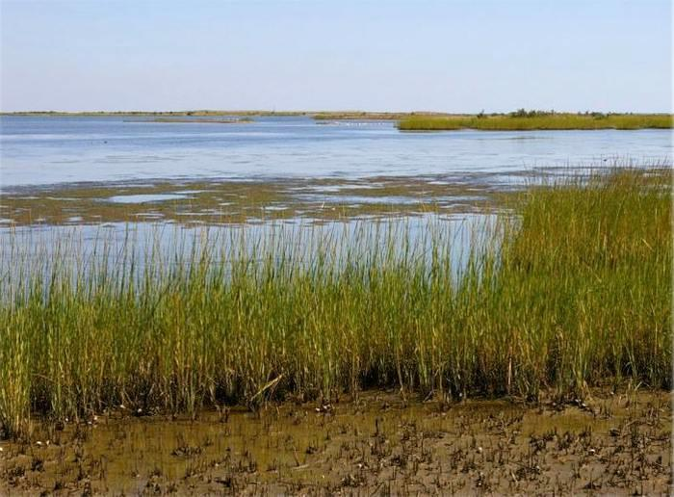
Conclusions - salinity
Freshwater inflow from diversions has increased available habitat for freshwater spp.
Patterns of abundance are generally not well correlated with salinity changes for estuarine species
Species of concern (brown shrimp, oysters, speckled trout) do not appear to have been negatively affected by salinity changes
Lack of stronger response because estuarine species are euryhaline – adapted to the environmental variability typical of an estuary
    Redistribution rather than removal from the estuary
Notes:
*Estuarine species generally euryhaline and adapted to environmental variability of estuary in order to take advantage of their high productivity.
*Species may seek out a specific salinity range, under which their growth is optimized. This leads to movement up and down the estuary.
*Such redistribution appears to have been the main response of fish and shellfish to diversion-related salinity changes, but this is characteristic of a natural, dynamic estuarine system.

Slide 16
Conclusions – food web
Effects of freshwater inflow from the diversions on food web interactions likely has been more significant
Riverine nutrients have stimulated plant productivity, and this productivity appears to have proliferated through the food web via numerous pathways
Inflow has also made high-quality habitats, such as SAV and the marsh surface, more available to fish and shellfish, thus providing another means whereby estuarine production is enhanced
The net result should be increased production of fish and shellfish (in terms of numbers, biomass, and/or caloric densities), which is consistent with positive relationship observed between freshwater inflow and fishery yields in other parts of world

Slide 17
Further Analyses
HSIs developed for 2012 Master Plan useful, but do not adequately describe changes in distribution or abundance
For 2017 Coastal Master Plan, we have consulted with experts to develop a strategy for selecting and applying the most appropriate fisheries models
Have decided to use a combined approach:
  Revise/improve 2012 HSIs: use field data to develop relationships with the goal to have more tangible outputs (relative abundance not habitat quality)
  Develop/employ an integrated EwE-Trosim ecosystem-level model: will evaluate how food web dynamics affect species responses to changes in environmental conditions
Notes:
*EwE-Trosim outputs will be relative to changes in biomass.

Slide 18
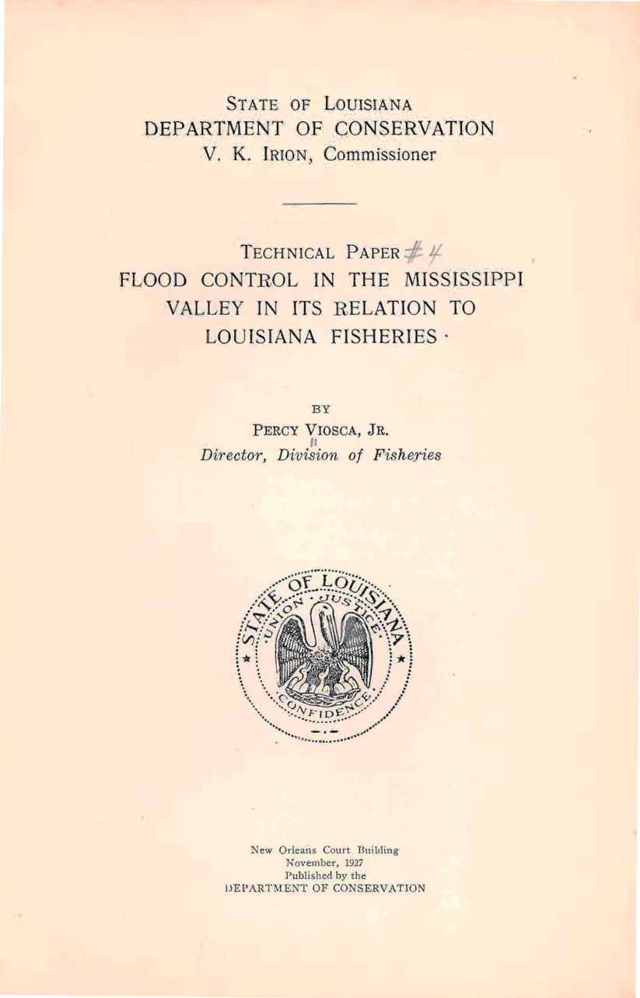
Historical Perspective
“It is true that on the coast some of the oyster beds close in are temporarily destroyed by excessive amounts of freshwater, but likewise many old reefs are rehabilitated.”
“The result in the case of oysters is largely a shifting of certain fishing grounds but the total oyster crop is decidedly increased.”
“As soon as the floods subside, young salt water shrimp migrate in great schools into those tide level lakes and bays…..and there they become more accessible to the shrimp fishermen……”
“The marine life of Louisiana differs fundamentally from that of the adjacent gulf states largely because of its ready adaptation to the temporary conditions produced annually by the Mississippi at flood time and the large majority of our valuable marine species thrive on floods.”
“Just as our aquatic birds and mammals have suffered by our present and past means of flood prevention, reclamation and drainage projects, so have our fisheries, both marine and fresh water.”
Notes:
*The proposed larger diversions won’t be a return to pre-levee conditions, but even so….
*Viosca in this report from 1927 maintained that the periodic floods were beneficial to fisheries (both fresh- and saltwater) due to capacity to fertilize/re-nourish the landscape.
*He also had observations pertinent to important fishing industries.

Slide 19
Brown Shrimp and White Shrimp – Fisheries Dependent Data
Data from Trip Tickets = documentation from fisherman/dealer describing the amounts, location, times, and methods used to collect seafood
Lake Pontchartrain Basin = the LDWF Shrimp reporting Basin that encompasses the Breton Sound estuary
Higher landings of white shrimp and lower landings of brown shrimp in recent years
Notes:
*Note that top graph shows pounds per trip, whereas the bottom graph shows total annual landings (no reports of level of effort in NMFS data).

Slide 20
Further Analyses
Research indicates that existing diversions have had an largely positive effect on fisheries – the effects of proposed larger diversions will need to be evaluated
2012 Coastal Master Plan utilized Habitat Suitability Indices (HSIs) coupled with ecosystem models to determine effect of projects on habitat quality of selected species
For Brown Shrimp (Baltz 2012):
HSI = (marsh vegetation coverage² x mean spring salinity x mean spring water temp.)
Habitat quality for brown shrimp lower with MP, generally due to lower salinity, but no outright collapse
From: Nyman et al. (2013)

Slide 21
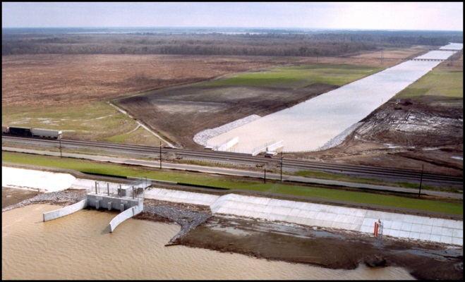
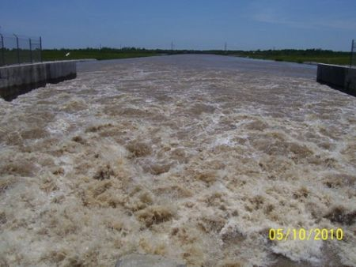
Take Home
Habitat loss is a greater threat to fisheries than salinity changes
Episodic floods are natural for Mississippi River Delta; fish and wildlife have adapted to take advantage of dynamic conditions
Diversions are most efficient way to build and sustain habitat
Other methods of restoration would not restore the processes that promoted the high productivity documented for the Delta
  Regular renourishment from the river
  Maintainence of salinity gradient with associated habitat diversity
Notes:
*Other methods of restoration primarily refers to the “dredge and fill-only alternative”

