Slide 1

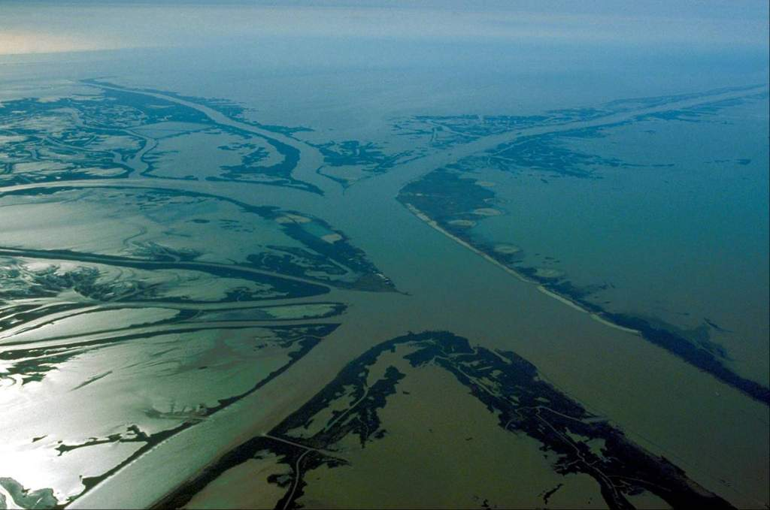
Mississippi River Geomorphic Assessment
David S. Biedenharn (Biedenharn Group,
Sub-Contractor to CDM-Smith)
Charles D. Little, Jr. (ERDC)

Slide 2
Products of the
Geomorphic Assessment
Document the historical trends of the channel system
Establish the current stability of the channel system and identification of the dominant processes and features within the system
Provides foundation for the calibration of numerical models and the proper interpretation of numerical model results
Notes:
I will talk about the primary products of the geomorphic assessment, and how it provides the foundation upon which the modeling efforts must build.

Slide 3
Geomorphic Assessment Approach
Data Compilation
Geometric Data Analysis
Gage & Discharge Analysis
Sediment Data Analysis
Dredge Data Analysis
Events Timeline
Integration
Notes:
A brief listing of the various tasks in the geomorphic assessment

Slide 4
Geometric Data Analysis
Comparative cross sections (crossings and pools)
Top width, cross sectional area/conveyance profiles
Channel invert profiles
Volumetric change & average net erosion/deposition
Detailed investigation of ORCC reach
Notes:
A brief listing of the various tasks in the geomorphic assessment

Slide 5
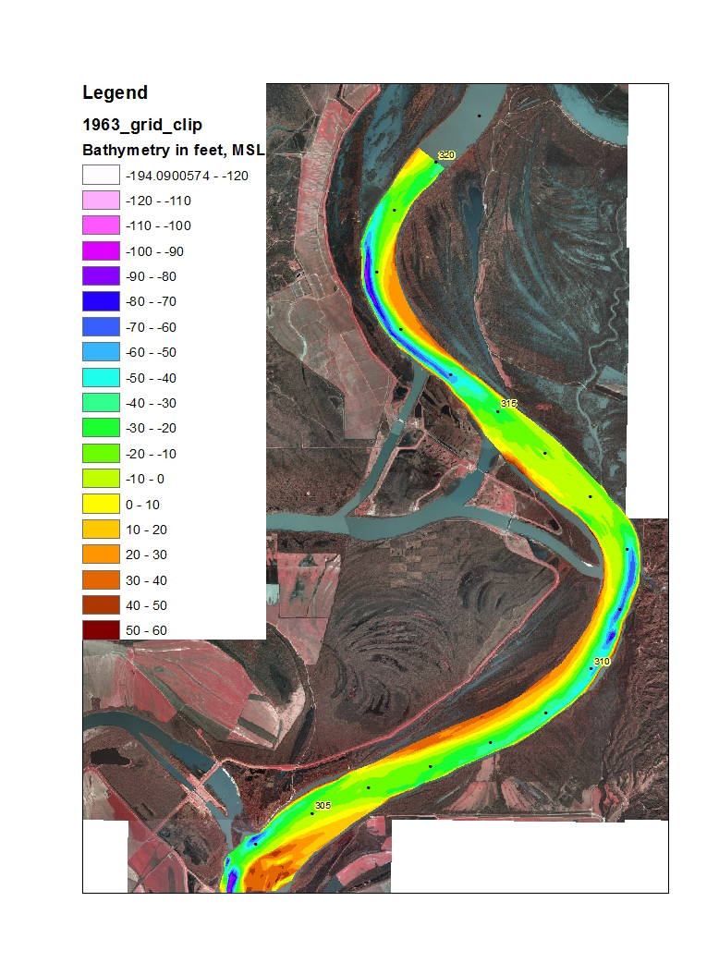
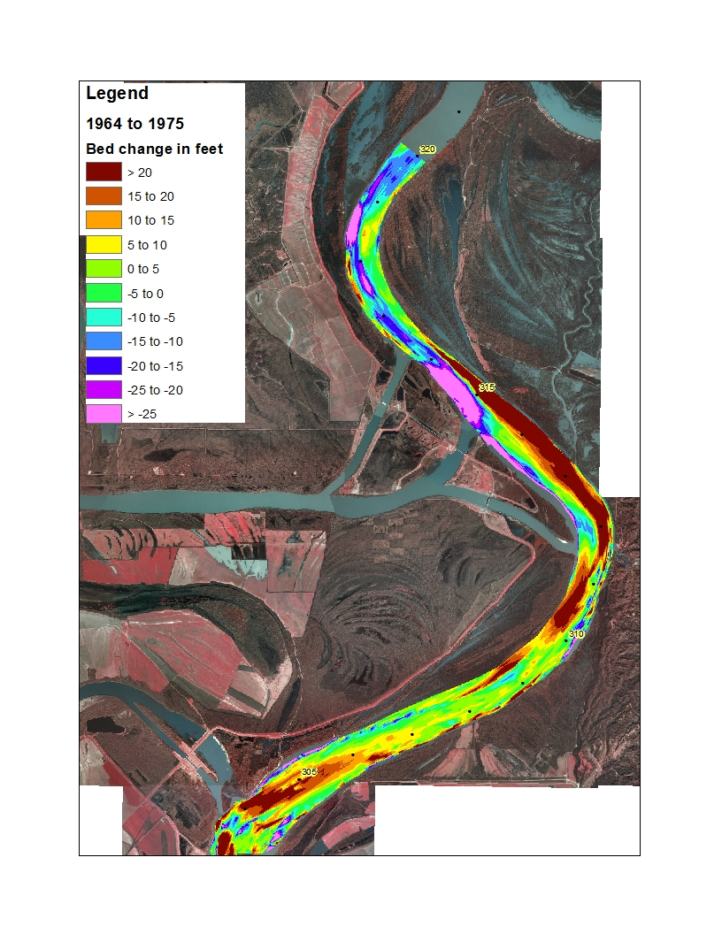
Hydrographic Surveys
Notes:
A brief discussion about the use of hydrographic surveys

Slide 6
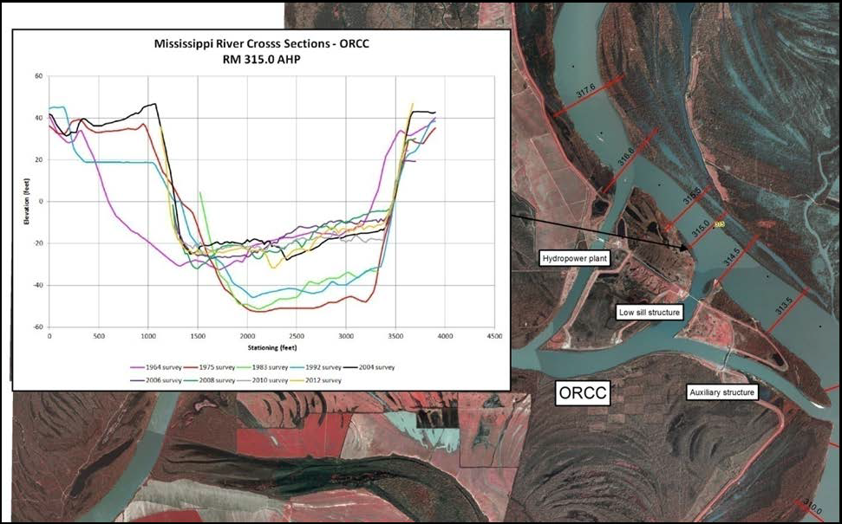
Cross Section Comparisons
Notes:
A brief discussion about the use of hydrographic surveys

Slide 7
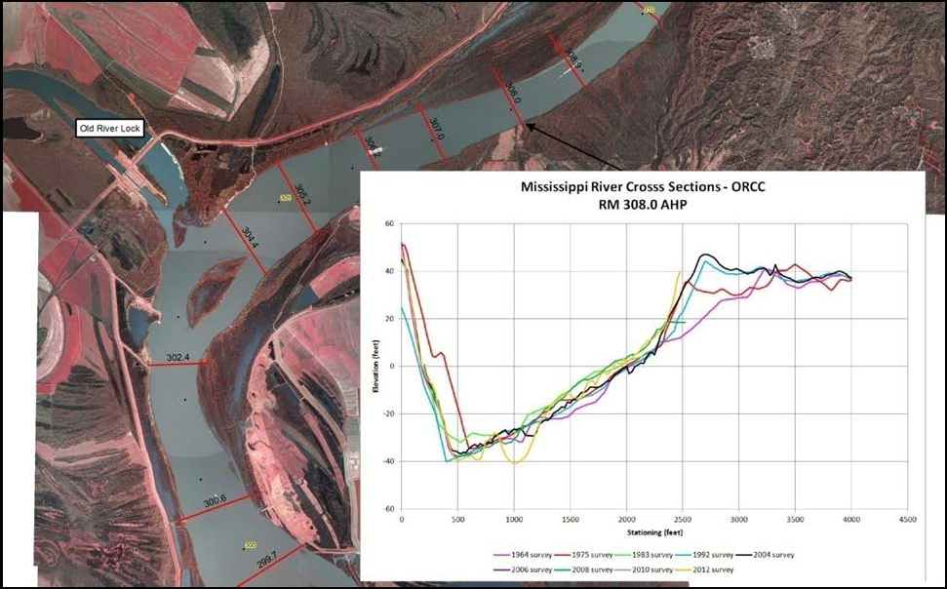
Cross Section Comparisons
Notes:
A brief discussion about the use of hydrographic surveys

Slide 8
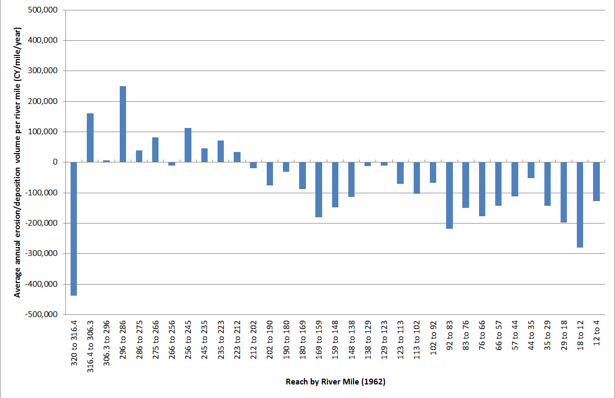
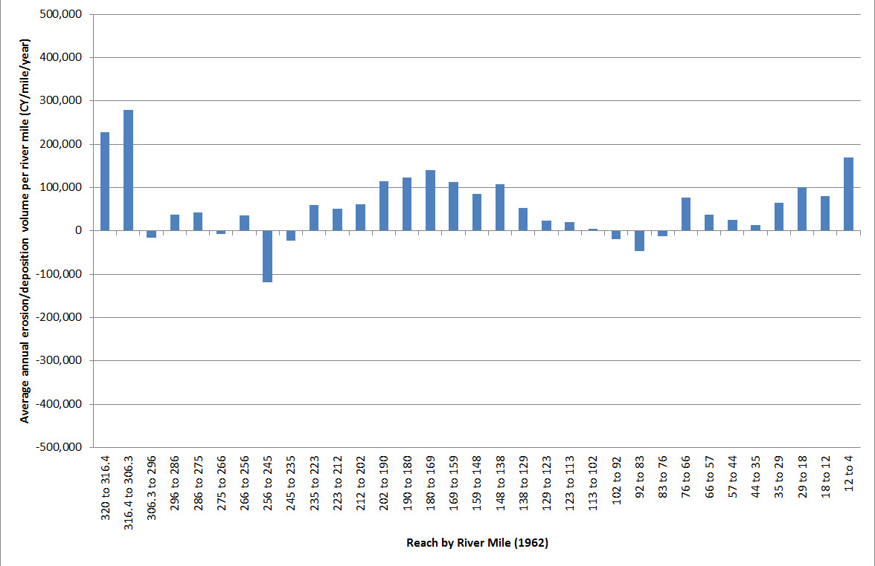
Erosion/deposition by reach
1963 - 1975
1992 - 2004
Notes:
A brief discussion about the use of hydrographic surveys

Slide 9
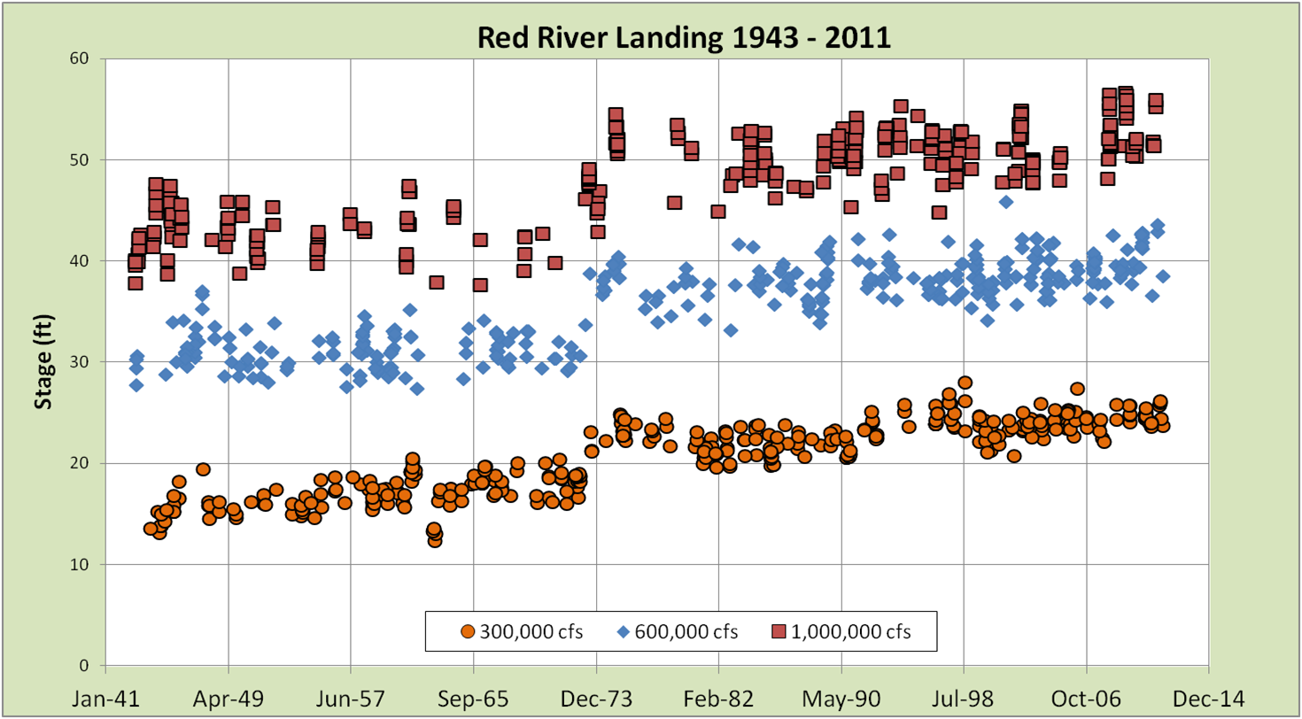
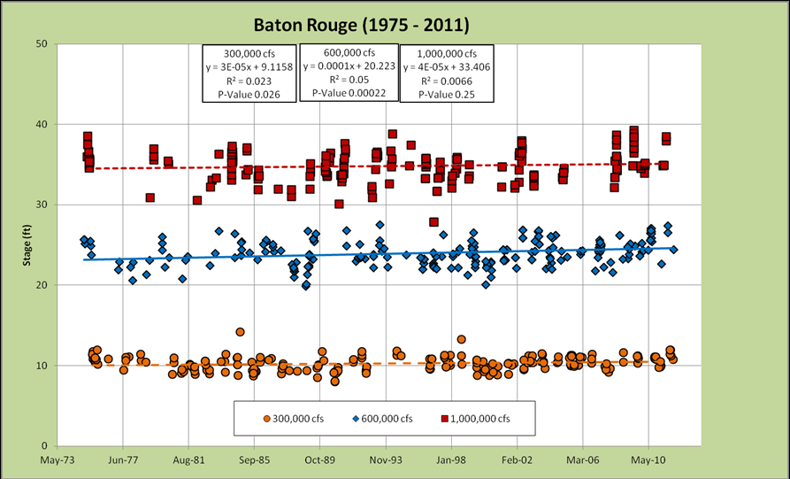
Specific Gage Records
Notes:
A brief description of the use of specific gage records to document channel stability. Will mention the effects of the 1973 flood and subsequent trends.

Slide 10
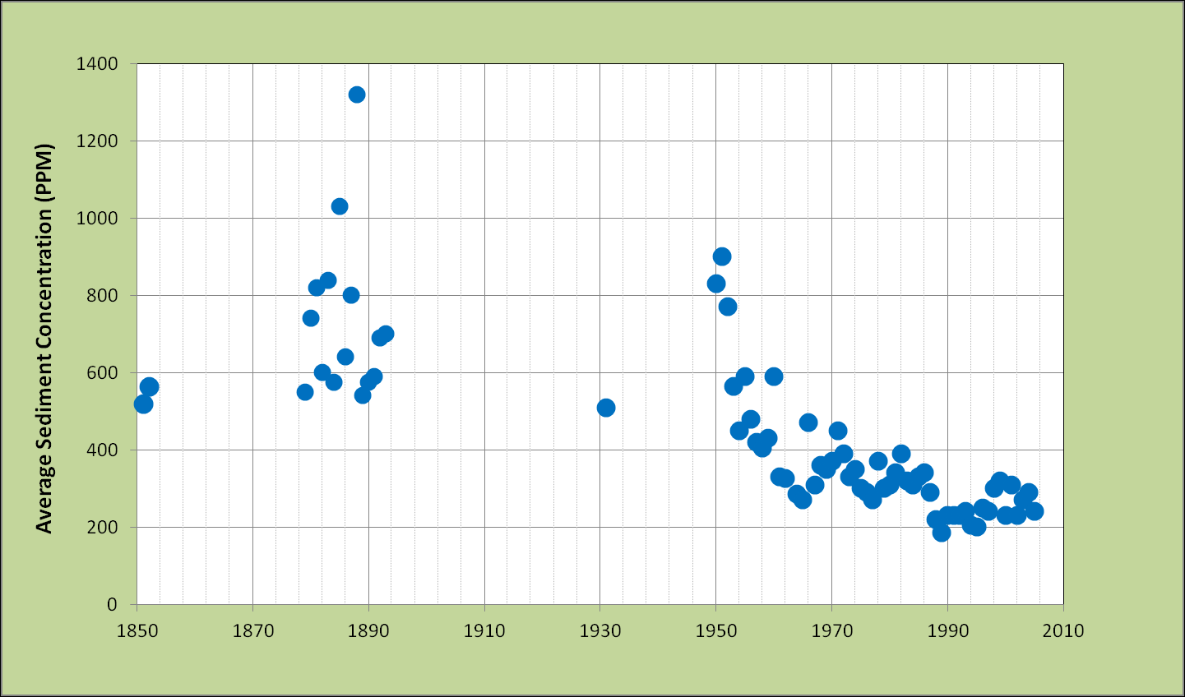
Mississippi River
Decreasing Sediment Trends
Notes:
A brief discussion of the sediment data analysis. Here I will mention the apparent long term decreases in sediment loads, but will also address some of the uncertainty in these estimates (historical gage locations vary, measurement techniques are not the same, possible accelerated loads in the 1800s due to New Madrid earthquake, and clearing of banks for steamboats, etc). I will also discuss how we need to distinguish between fine loads and sand loads.

Slide 11
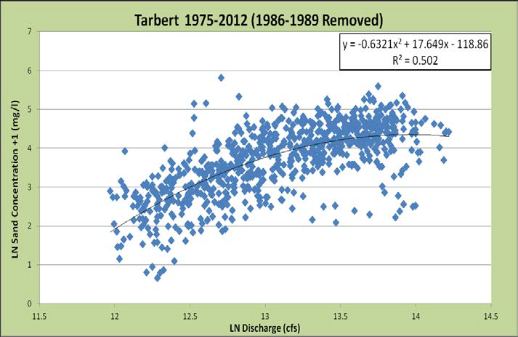
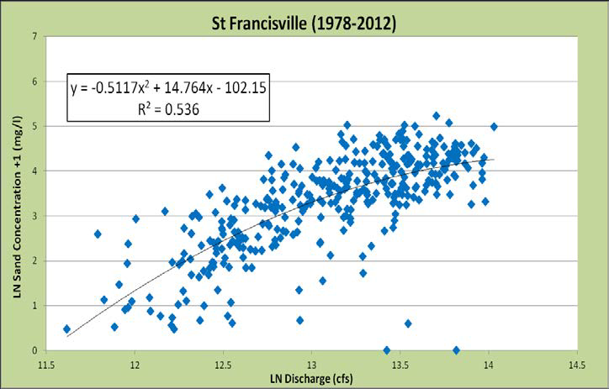
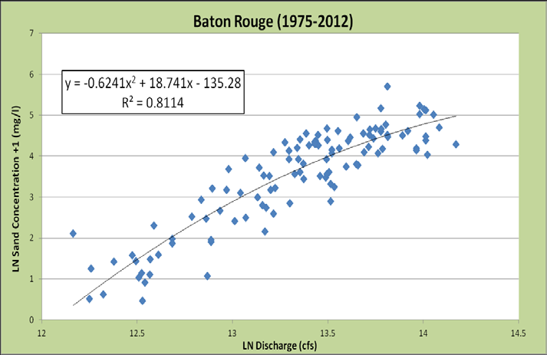
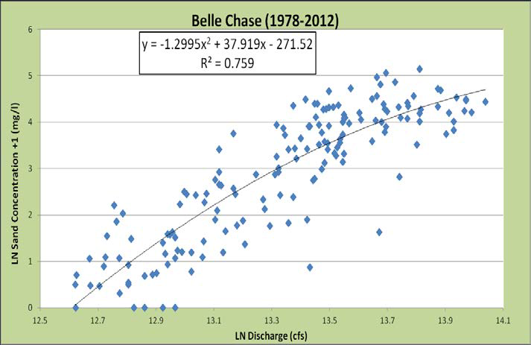
Sediment Budget
Notes:
A brief discussion of the use of dredge records with note of the increase due to change from 40’ to 45’ channel

Slide 12
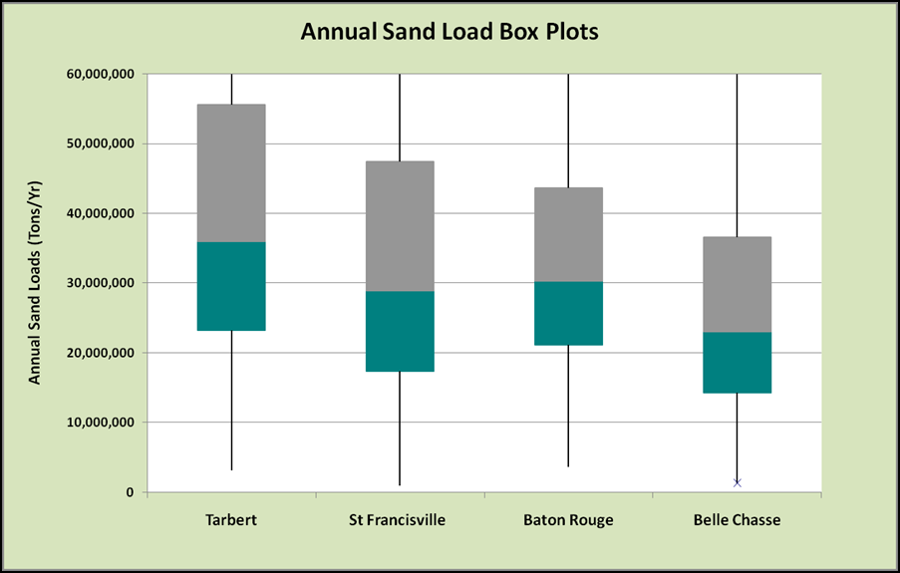
Sand Budget
Notes:
A brief discussion of the use of dredge records with note of the increase due to change from 40’ to 45’ channel

Slide 13
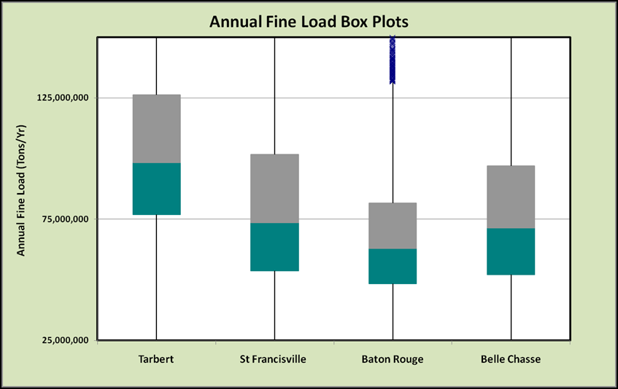
Fine Sediment Budget
Notes:
A brief discussion of the use of dredge records with note of the increase due to change from 40’ to 45’ channel

Slide 14
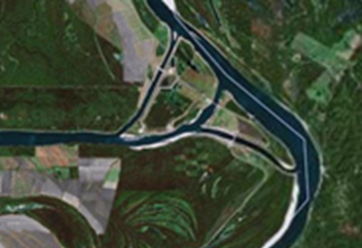
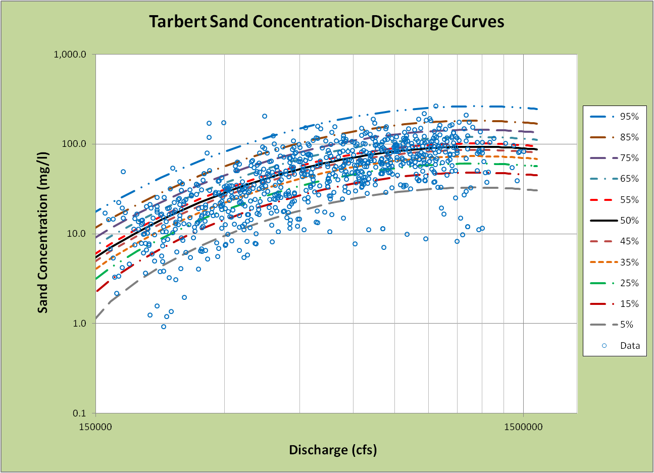
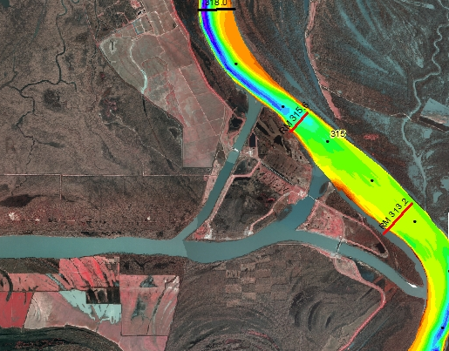
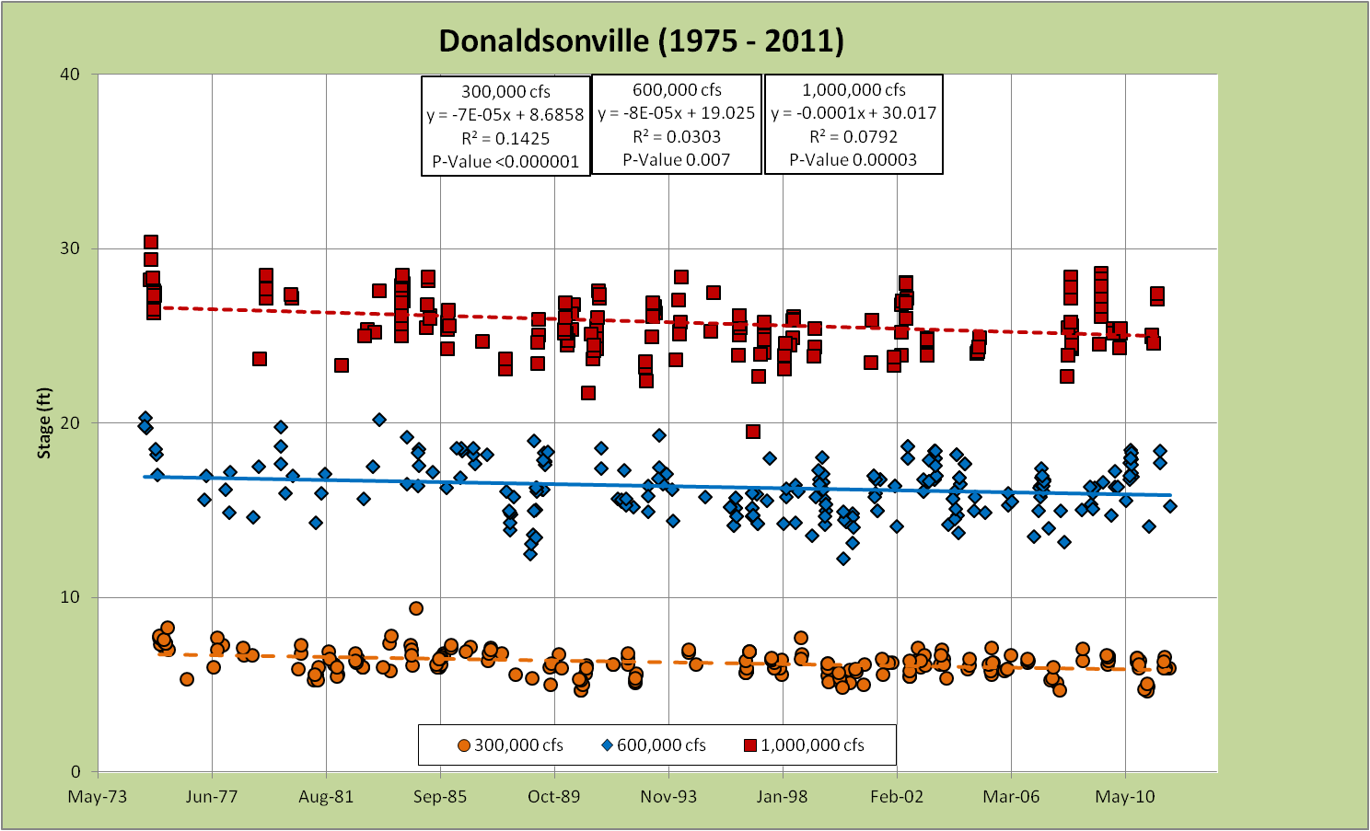
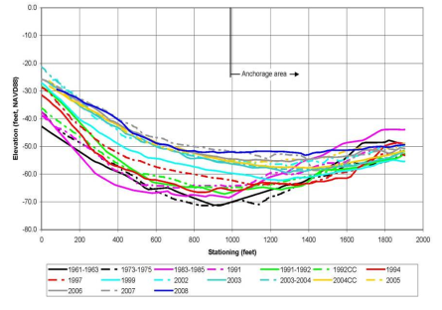
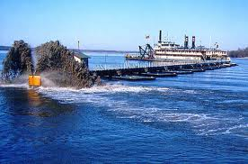
Integration
?
Notes:
Discuss how we integrate all the various geomorphic assessment tasks

Slide 15
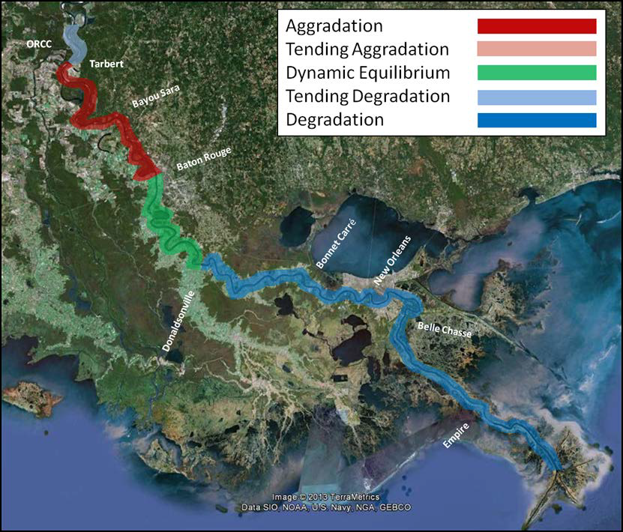
1960s to 1970s
Notes:
Geomorphic trends 1960s to 1970s with mention of the 1973 flood.

Slide 16
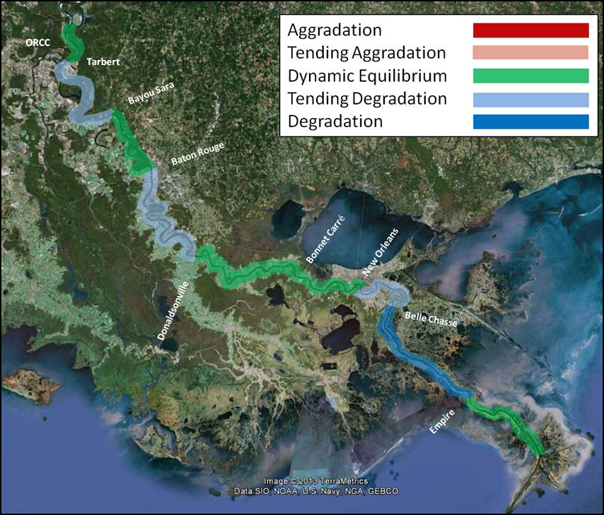
1970s to 1990s
Notes:
Geomorphic trends 1970s to 2000s.

Slide 17
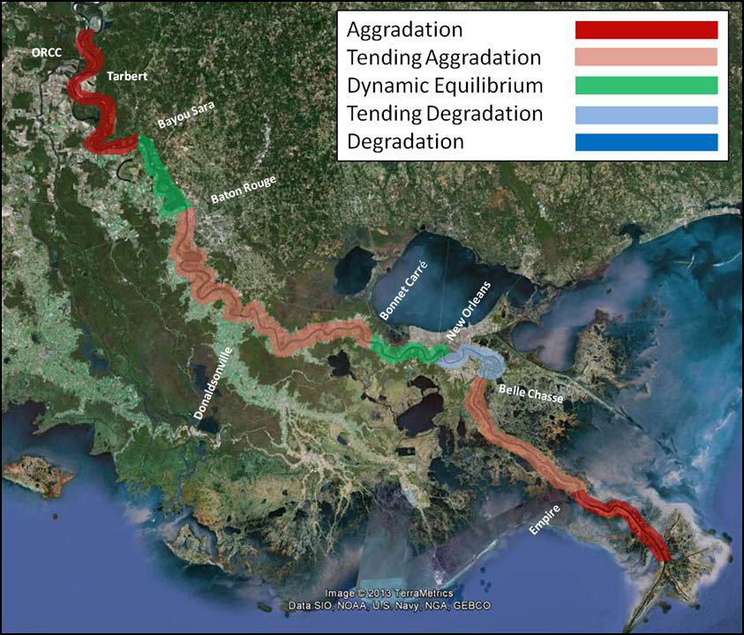
1990s to 2000s
Notes:
Geomorphic trends 1970s to 2000s.

Slide 18
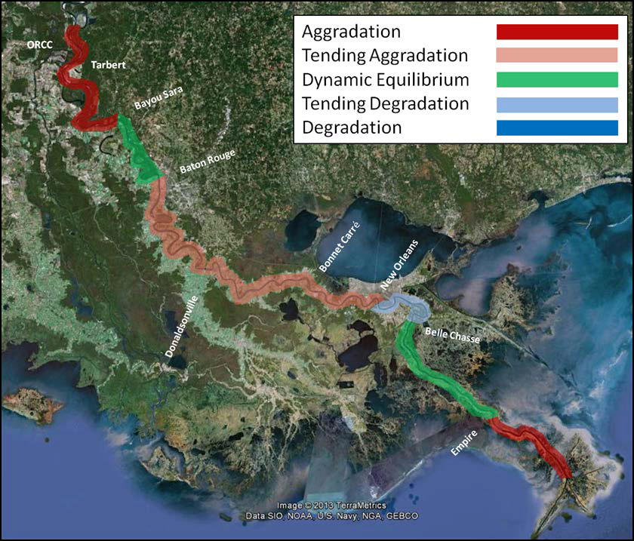
1970s to 2000s
Notes:
Geomorphic trends 1970s to 2000s.

Slide 19
Geomorphic Assessment Summary
It is important to recognize the natural variability of the system and uncertainty in observed data (i.e., timing of surveys, specific gage trends, sediment data uncertainty, etc.)
The most significant impacts to observed channel morphology appear to be associated with the 1973 flood and ORCC.
The geomorphic assessment highlighted the importance of considering spatial and temporal variability when assessing channel stability.
Recognition of the regime of a river reach encompassing proposed diversion locations is important.
Notes:
A brief listing of the various tasks in the geomorphic assessment

Slide 20
QUESTIONS
David Biedenharn
biedenharngroup@yahoo.com
Charlie Little charles.d.little@usace.army.mil

