Slide 1
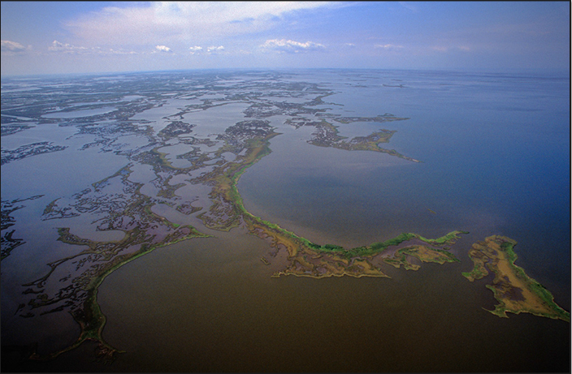
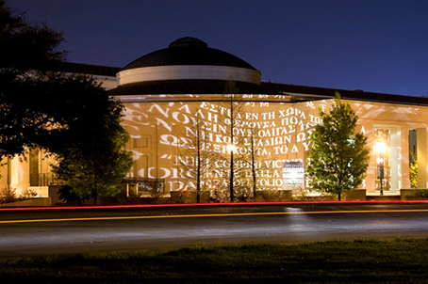
Margaret Reams, Ph.D.
LSU Department of Environmental Sciences mreams@lsu.edu
Resilient Human Communities
Social-Ecological Resilience Theory

Slide 2

Social-Ecological Resilience provides a theory base and evaluative framework for:
Sustainable development
Wiser use and protection of natural resources & environmental services
Adaptation to reduce exposure to or recovery from disruptive events – either fast-moving or slow-moving disturbances

Slide 3
Some Definitions of Resilience
“Resilience reflects the degree to which a complex adaptive system is capable of self-organization and the degree to which the system can build capacity for learning and adaptation.”
“The capacity of linked social-ecological systems to absorb recurrent disturbances such as hurricanes or floods so as to retain essential structures, processes, and feedbacks.”
From Adger et al., 2005, Science Vol. 309

Slide 4
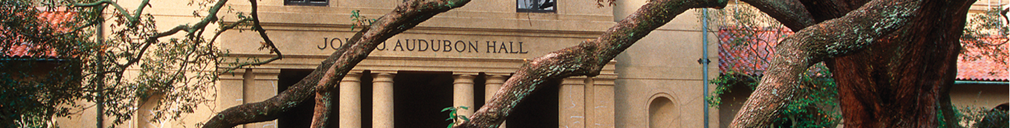
Thinking of Linked Social-Ecological Systems
The Raft – A Metaphor of Stability and Resilience
Ludwig’s model is useful (2002).
The raft’s system? Raft + Weight + Lake System
Disruptions? Either rapid or slow increase in weight.
Key Variables? Include Adaptive Behavior of Occupants

Slide 5
What Influences the Raft’s Resilience?
Its own physical characteristics
The environment into which it’s deployed
Institutions for decision making
Resources of inhabitants to adapt to changing risks
Awareness of changing environmental risks
Extent to which information is shared among stakeholders
Raft’s resilience can’t be determined without considering these factors.

Slide 6
Dimensions of Resilience
Ability to Self-Organize
Holistic Understanding of Changing Risks
Ability to Adapt
Community Attributes
Social Networks & Associations
Information Sharing
Inclusive Decision Making
Reflects Sound Science
New Knowledge Acquisition
Strong Local Knowledge Base
High Stakeholder Participation
Risk Mitigation Tools
Flexibility among Decision Makers

Slide 7

Lam & Reams’ Resilience Inference Measurement (RIM) model for measuring community resilience

Slide 8
Discriminant analysis results – county level
52 coastal counties along the Gulf of Mexico
Classified into 4 groups according to # coastal hazards, property damage, population growth over time (“resilience”)
24 variables representing demographic, social capital, economic, government, and environmental
Discriminant analysis led to 94% counties correctly classified
Notes:
Group 4, the highest resilient group, is highly positively correlated with percent of civilian labor force and mean elevation and they are mostly located in the Florida panhandle and Alabama area. Group 3 linked with higher rent and older popn.

Slide 9
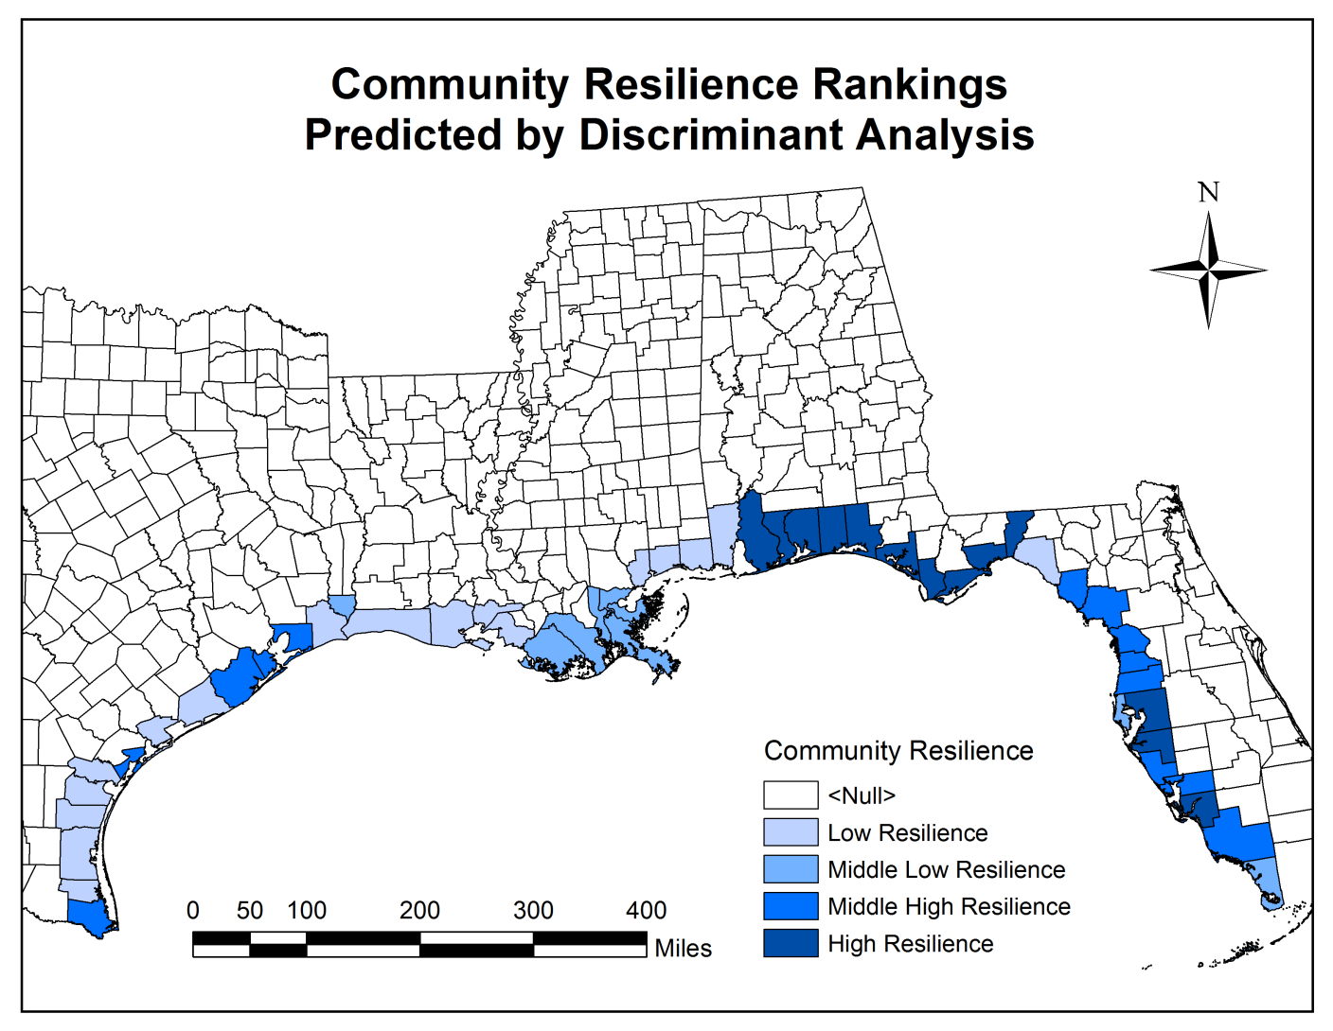
Spatial Distribution of Rankings

Slide 10
Conclusions
Obviously need refinements, but a promising approach
From discriminant analysis, an index can be computed based on the probability of group membership; the technique can be used to predict the resilience group of other counties
Resilience needs to incorporate a temporal dimension
A meaningful, empirically-tested resilience index can help identify aspects of activities that will increase or decrease resilience, thus a useful tool for sustainable planning and management

